Slide 1



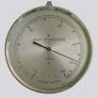


Estimation of a Normal Process Variance
from Measurements
with Large Round-Off Errors
Diamanta Benson-Karhi, the Open University of Israel
Edna Schechtman, Ben-Gurion University

Slide 2





Measurement Errors
Measurement is the process of
assigning a number to a measurand
which is a random variable.
Measurements are used to estimate the
"true" value of the measurand using
special measuring instrument
and a specified technical procedure.
the resulting outcome of the measurement
the "true" value of the measurand
the deviation of X from its mean value
the pure measurement error
systematic measurement error
Random measurement error
Gertsbakh, I., (2003), Measurement Theory for Engineers, Springer-Verlag, Berlin Heidelberg.

Slide 3


Round-off Errors
Statistical methods are based on an
assumption that numerical data are
"exact” (infinite number of decimal places).
Measured and archived data are sometimes rounded-off.
Rounding-off may occur due to the characteristics of a measuring instrument or from post-processing of raw data before archival.
Ignorance of the rounding-off can render elementary methods of statistical inference inappropriate and misleading.
Round-off error is typically systematic

Slide 4
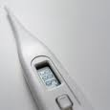
Large Round-off Errors
Measuring instruments have readings
with a discrete scale with step h.
Typically measurement results are rounded-off to the
nearest half of the interval between the adjacent scale marks.
The value of h depends on the measuring instrument's precision.
The desired precision must depend on the spread of the
measurement results in the population.
Gertsbakh, 2003
Cochran and Cox, 1957
Regular measurements
Special measurements
Regular estimation procedure
Modified estimation procedure

Slide 5
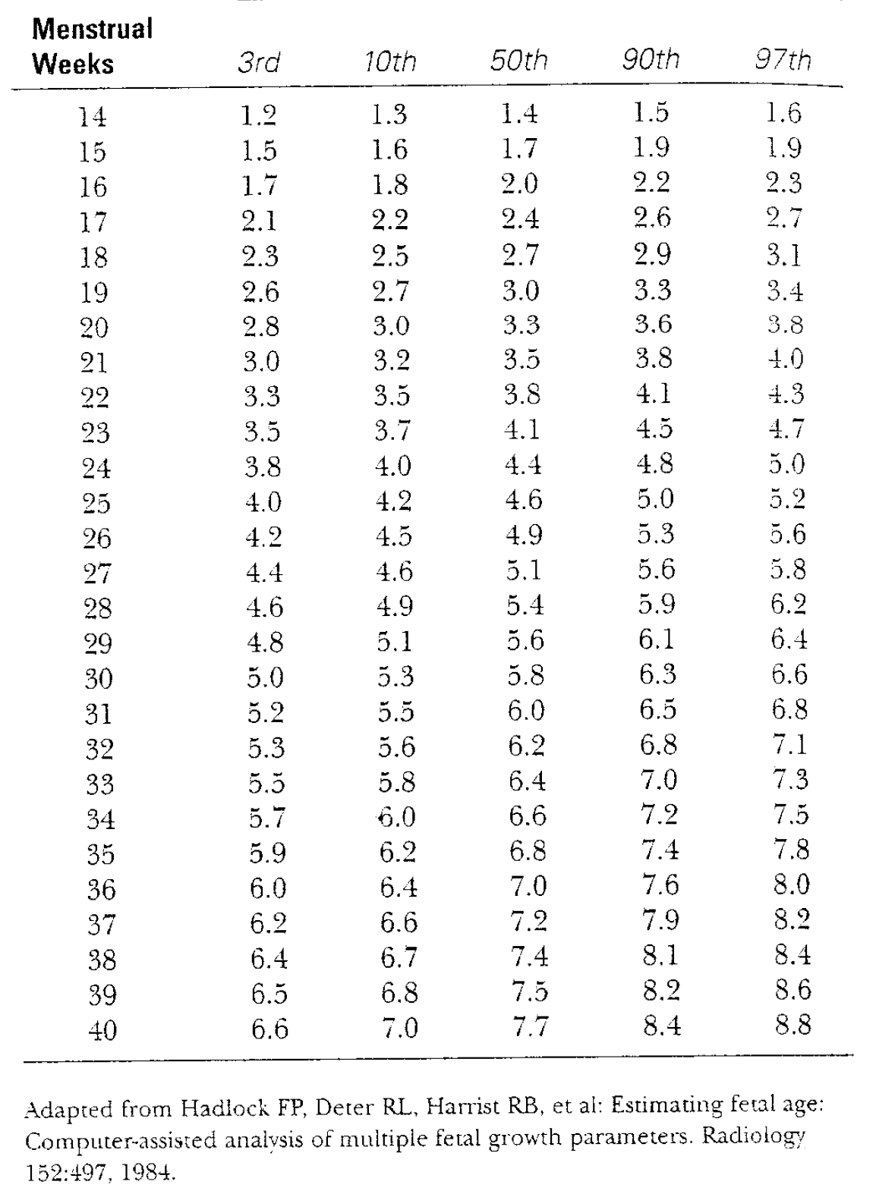
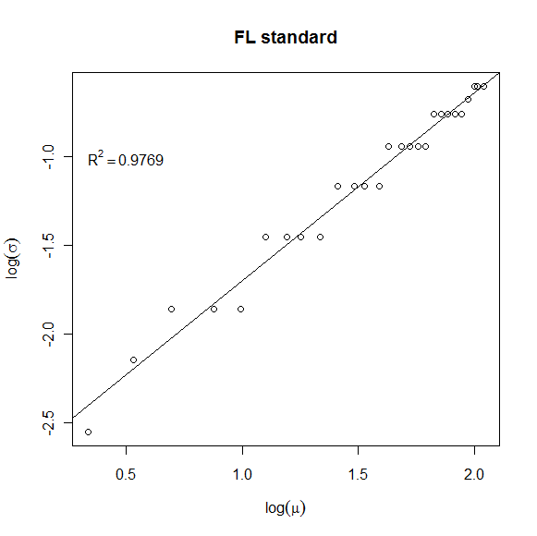
Numerical example – Fetal Femur Length

Slide 6

Round-Off Errors in Normally Distributed Measurements
the rounded values of the measurand
the integer
part of X
the round-off error
The measurand
h₀ denotes the mode
Y_{i} takes a maximum
of 5 different values
Box and Luceno (1997) and Krylov (1950)

Slide 7

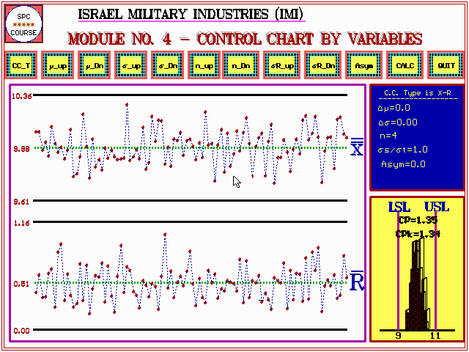
Variance Point Estimation from Rounded Data
Basic Assumptions:
The round-off error (η) is the only measurement error (Gertsbakh, 2003).
μ_{X} is known.
The naïve estimator
Pretends that the observed data are the true values.
Uses the sample variance of the Y’s
to estimate the variance of X.
Numerical Example
Consider h=1, μ_{X=}0.5, σ_{X}=0.25.
δ=0.25<0.5 YЄ[0,1] with probability 0.5.
For n=5, P(either all 0’s or all 1’s)=2/32
P(4 times 0 and one time 1 or visa versa)=10/32

Slide 8


Popular
Sheppard’s Correction (1898)
Simple
Non-parametric
X and η are independent
Sheppard's correction

Slide 9
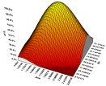

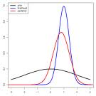
Maximum Likelihood Estimation (MLE)
Parametric (normal distribution)
A size-n sample of rounded-off measurements:
The likelihood function of the sample y:
μ_{X} is assumed to be known.
Log(L) is unimodal Finding MLE is well defined
More accurate than Sheppard’s correction
y= y₁,y₂,…,y_{n}
Schader and Shmid (1984) and Gertsbakh (2003)

Slide 10

The Calibration Model
Calibration Curve
y = f(x)
measurement
calibration curve
measurand
Calibration Model
Y= f(x)+ε
E(Y|x)=f(x)
random variable
zero-mean random variable
unknown
f(x)
collect preliminary data series (exact known x versus Y)
estimate f(x)
by
we will use this technique in order to estimate based on the observed

Slide 11
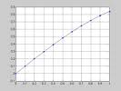
The Calibration Model for Variance Estimation
h, μ_{X}
P(Y=y)=f(σ_{X})
f(·) is unknown
δ, h₀, μ_{X}
calibration function:
polynomial proximity
The polynomial degree
finding the
n roots of
the equation
the vector of the polynomial coefficients

Slide 12
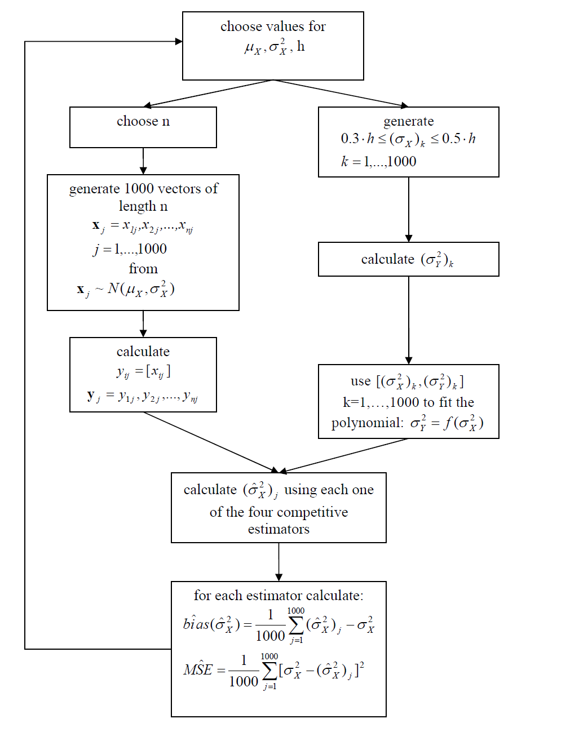

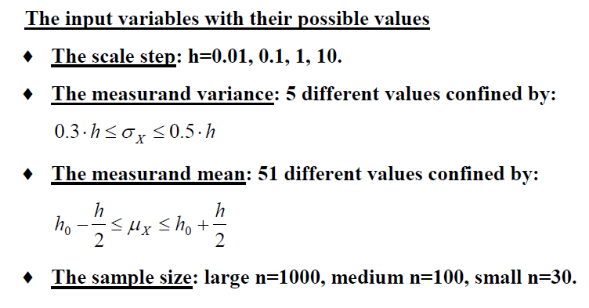
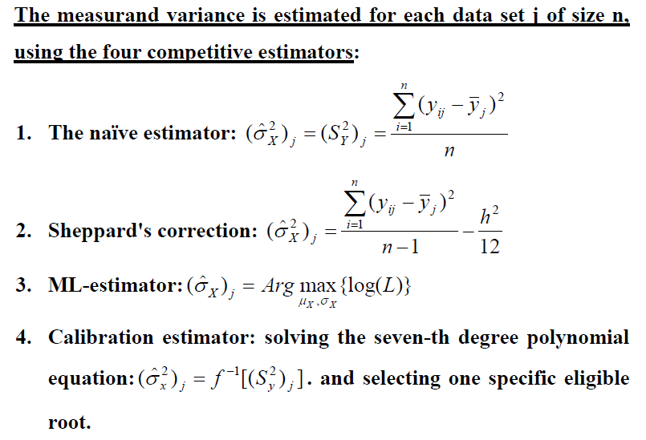
Simulation
Description

Slide 13
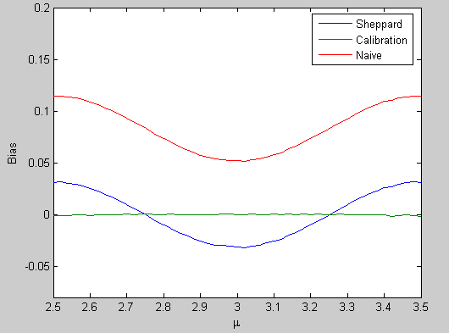

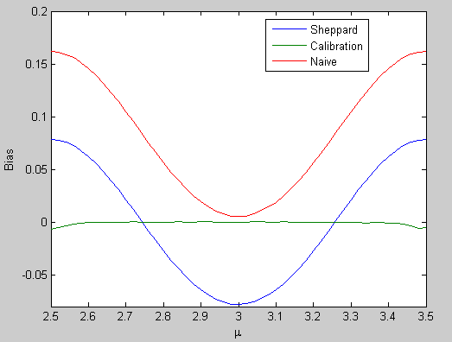
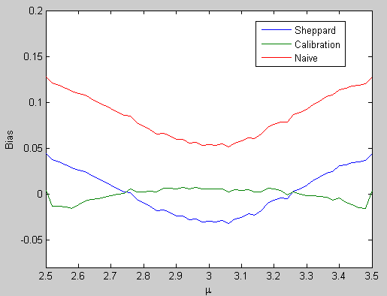
Results/Bias
n=1000
h=1
h₀=3
δ=0.4
h²/12
δ=0.4
n=100
δ=0.4
n=30
δ=0.3

Slide 14
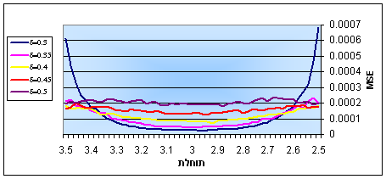
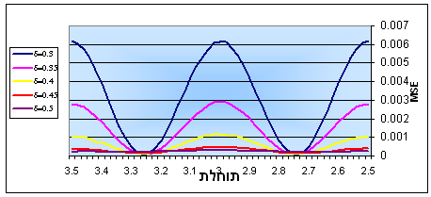
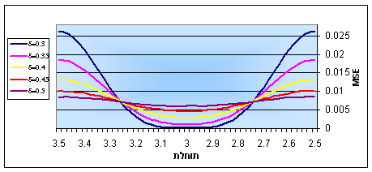
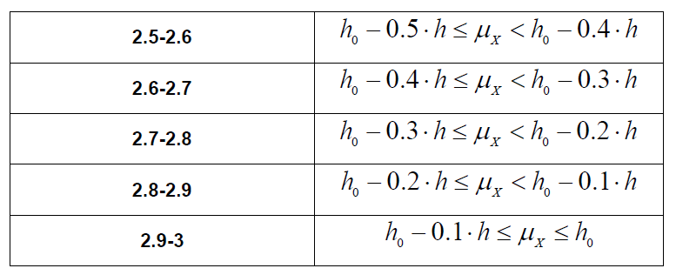
Results/MSE
Calibration n=1000
μ_{X}
Sheppard n=1000
Naïve
n=1000
μ_{X}
μ_{X}

Slide 15
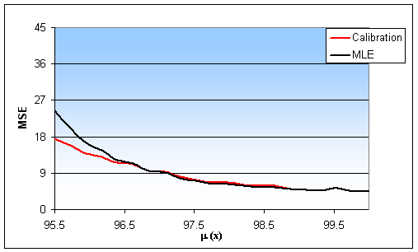
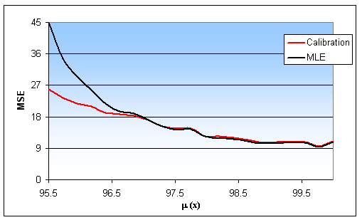
n=100
h=10
δ=0.35
h₀=100
n=50
h=10
δ=0.35
h₀=100

Slide 16
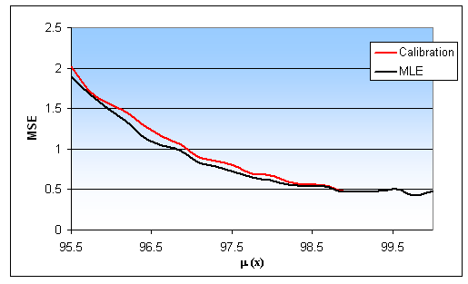
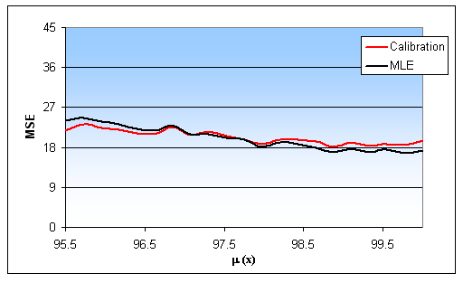
n=1000
h=10
δ=0.35
h₀=100
n=100
h=10
δ=0.5
h₀=100

Slide 17

Conclusions
Calibration/Naïve/Sheppard
The calibration estimator is unbiased.
The calibration estimator is not affected from changes in μ_{X} or δ.
Sheppard correction is accurate in for every δ and n.
Sheppard correction is not always better than the naïve estimator.
The calibration model is better than both a-parametric estimators.
Calibration/MLE
In most cases the calibration model and MLE are equally accurate.
The calibration model performs better close to the half point.
The MLE performs better close to the mode.
MLE is more sensitive to changes in the sample size (n).
At the half point MLE usually can’t find any solution.

Slide 18
Comparison Criteria

Slide 19
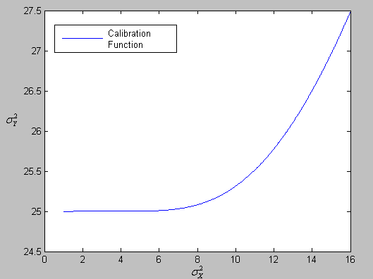
The half point
μ_{X}=35
h=10

Slide 22
The mean and the variance of Y

