Slide 1
Dense correspondences across scenes and scales
Tal Hassner
The Open University of Israel
CVPR’14 Tutorial on
Dense Image Correspondences for Computer Vision

Slide 2
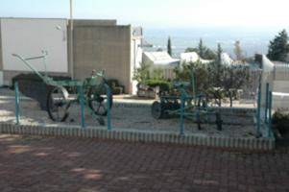
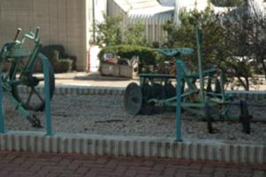
Matching Pixels
In different views, scales, scenes, etc.
Invariant detectors + robust descriptors + matching

Slide 3
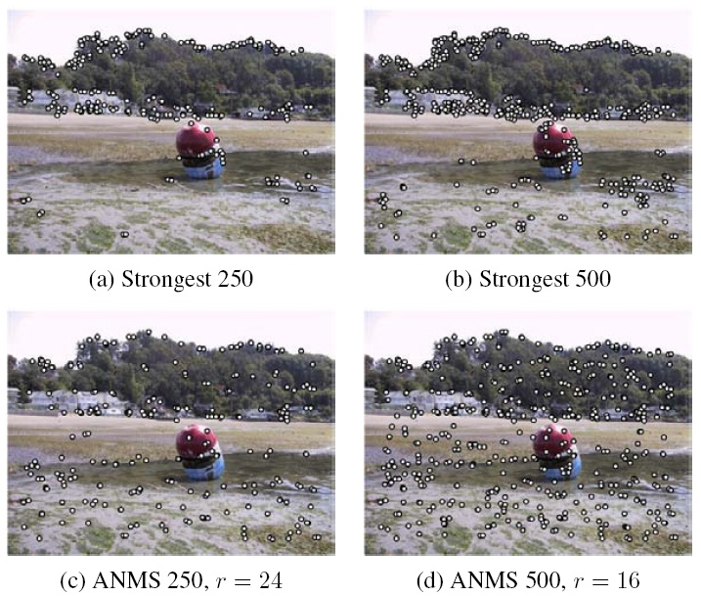
Observation:
Invariant detectors require dominant scales
BUT
Most pixels do not have such scales
Source: Szeliski’s book

Slide 4
Observation:
Invariant detectors require dominant scales BUT Most pixels do not have such scales
But what happens if we want dense matches with scale differences?
Source: Szeliski’s book

Slide 5
Dense matching with scale differences
Solution 1:
Ignore scale differences – Dense-SIFT

Slide 6
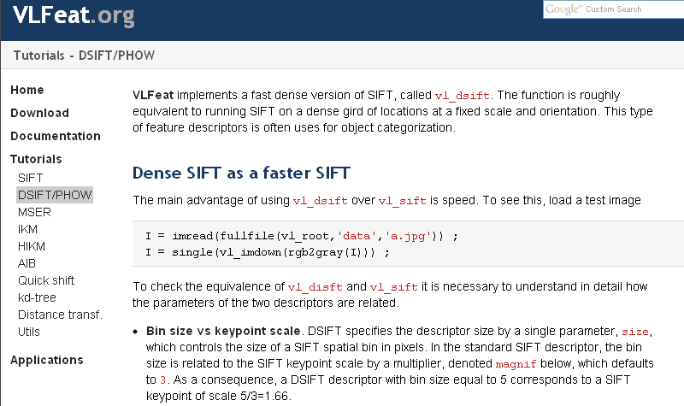
Dense SIFT (DSIFT)
Arbitrary scale selection
A. Vedaldi and B. Fulkerson, VLFeat: An open and portable library of computer vision algorithms, in Proc. int. conf. on Multimedia (ICMM), 2010

Slide 7
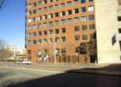
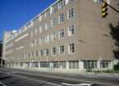
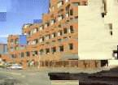
SIFT-Flow
Left photo
Right photo
Left warped onto Right
“The good”: Dense flow between different scenes!
C. Liu, J. Yuen, A. Torralba, J. Sivic, and W. Freeman, SIFT flow: dense correspondence across different scenes, in European Conf. Comput. Vision (ECCV), 2008
C. Liu, J. Yuen, and A. Torralba, SIFT flow: Dense correspondence across scenes and its applications, Trans. Pattern Anal. Mach. Intell. (TPAMI), vol. 33, no. 5, pp. 978–994, 2011

Slide 8
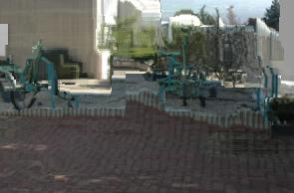
SIFT-Flow
Left photo
Right photo
Left warped onto Right
“The bad”: Fails when matching different scales
C. Liu, J. Yuen, A. Torralba, J. Sivic, and W. Freeman, SIFT flow: dense correspondence across different scenes, in European Conf. Comput. Vision (ECCV), 2008
C. Liu, J. Yuen, and A. Torralba, SIFT flow: Dense correspondence across scenes and its applications, Trans. Pattern Anal. Mach. Intell. (TPAMI), vol. 33, no. 5, pp. 978–994, 2011

Slide 9
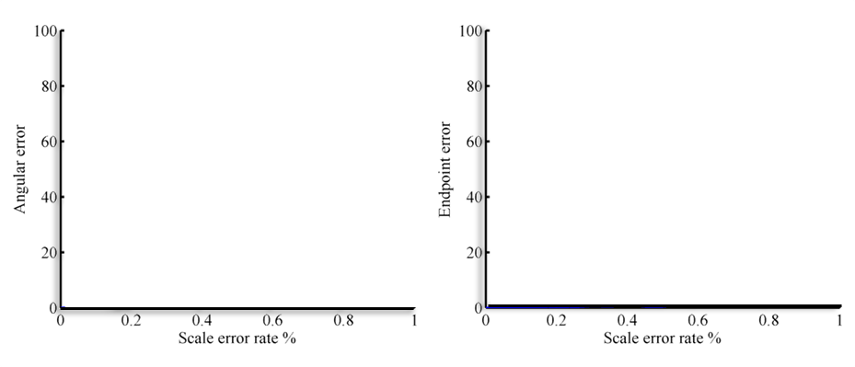
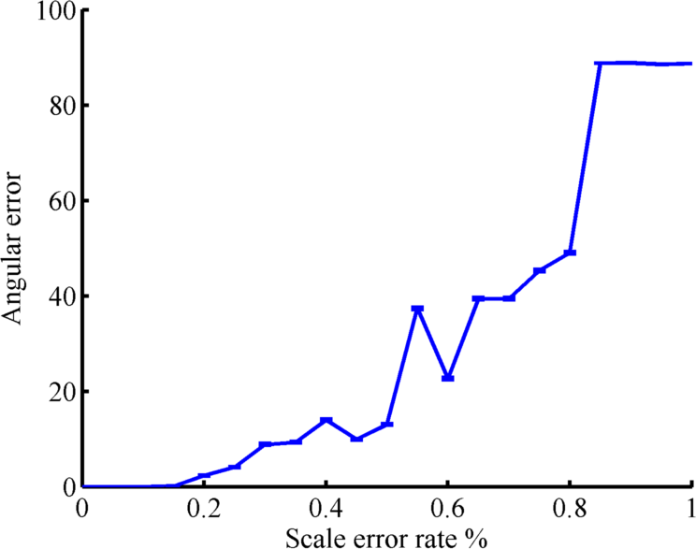
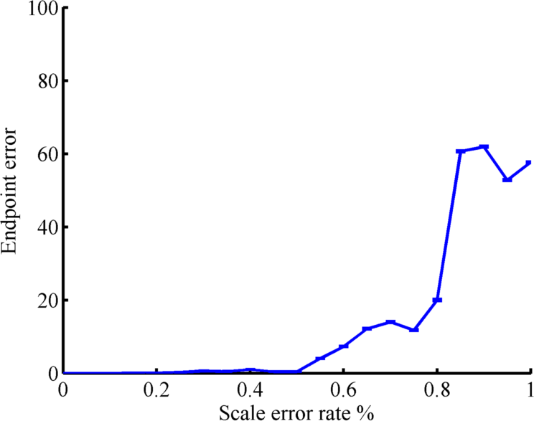
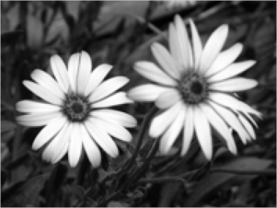
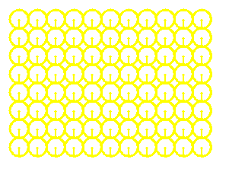
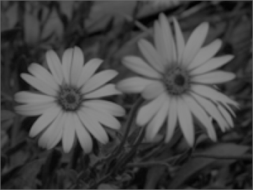
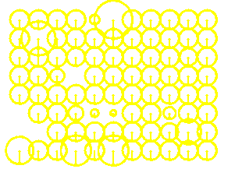
What’s happening?
This is what happens when one image is zoomed!!!
…yet remains robust even until 20% scale errors
20%
50%
80%

Slide 10
Dense matching with scale differences
Solution 2:
Multi-scale descriptors
Scale Invariant Descriptors (SID) [Kokkinos and Yuille’08]
Scale-Less SIFT (SLS) [Hassner, Mayzels, Zelnik-Manor’12]
Kokkinos and Yuille, Scale Invariance without Scale Selection, IEEE Conf. on Computer Vision and Pattern Recognition (CVPR), 2008

Slide 11
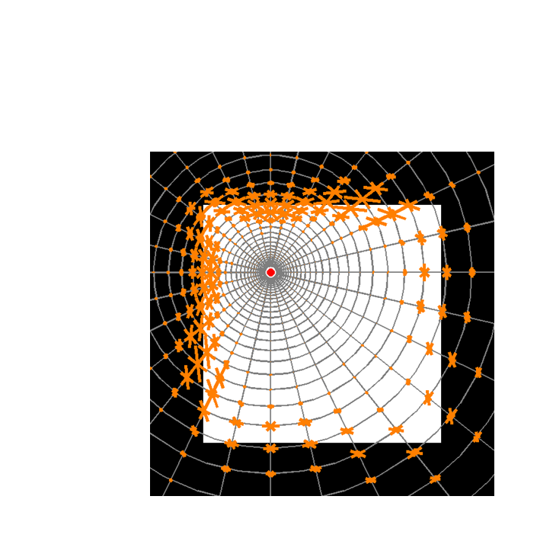
SID: Log-Polar sampling
$$r$$
$$θ$$

Slide 12
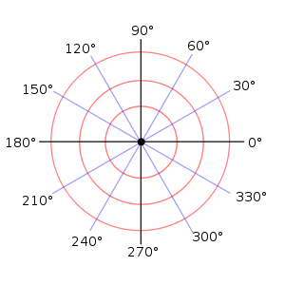
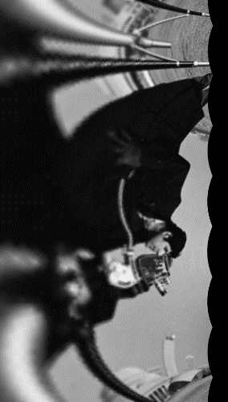
SID: Rotation + scale -> translation
$$r$$
$$θ$$
$$r$$
$$θ$$
$$r$$
$$θ$$

Slide 13
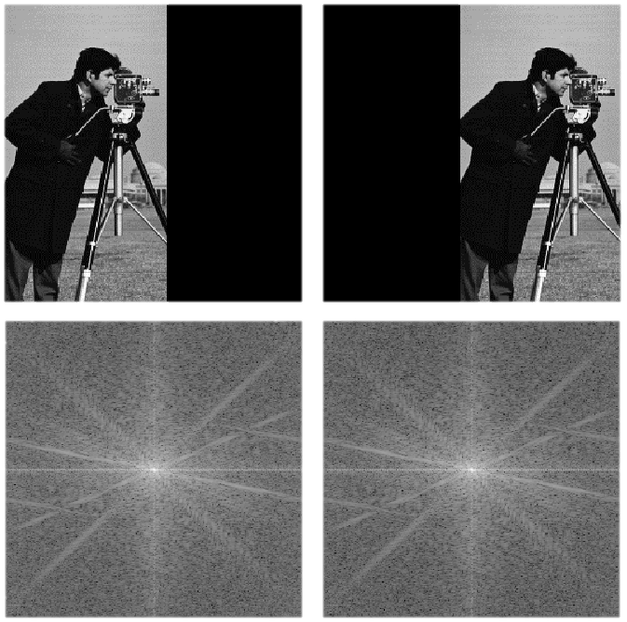
SID: Translation invariance
Absolute of the Discrete-Time Fourier Transform

Slide 14
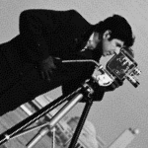
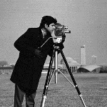
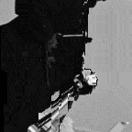
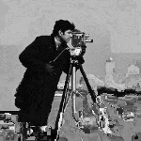
SID-Flow
Left
Right
DSIFT
SID

Slide 15
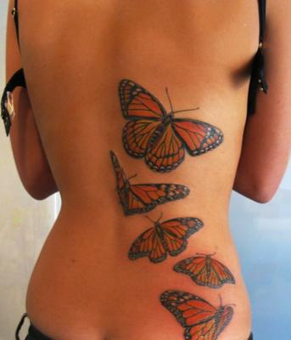
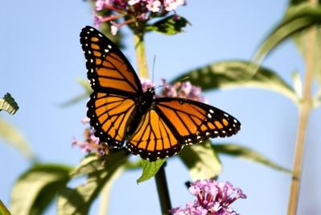
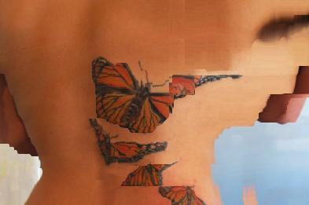
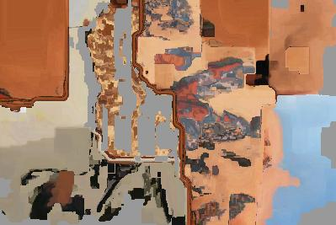
SID-Flow
Left
Right
DSIFT
SID

Slide 16
Dense matching with scale differences
Solution 2:
Multi-scale descriptors
Scale Invariant Descriptors (SID) [Kokkinos and Yuille’08]
Scale-Less SIFT (SLS) [Hassner, Mayzels, Zelnik-Manor’12]
T. Hassner, V. Mayzels, and L. Zelnik-Manor, On SIFTs and their Scales, IEEE Conf. on Computer Vision and Pattern Recognition (CVPR), 2012

Slide 17
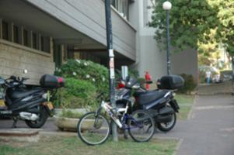
SIFTs at multiple scales
Compute basis (e.g., PCA)
This low-dim subspace reflects SIFT behavior through scales at a single pixel

Slide 18
Matching
Use subspace to subspace distance:

Slide 19
To Illustrate
…if SIFTs were 2D
Comparing DSIFTs (single scales)
$${\text{h}}_{σ_{i}}^{}$$
$${\text{h}}_{σ_{i}}^{′}$$

Slide 20
To Illustrate
…if SIFTs were 2D
Comparing SIFTs at multiple scales
$${\text{h}}_{σ_{i}}^{}$$
$${\text{h}}_{σ_{i}}^{′}$$

Slide 21
To Illustrate
Comparing subspaces of SIFTs from multiple scales!
θ

Slide 22
The Scale-Less SIFT (SLS)
Map these subspaces to points!
[Basri, Hassner, Zelnik-Manor, CVPR’07, ICCVw’09, TPAMI’11]
For each pixel p

Slide 23
The Scale-Less SIFT (SLS)
Map these subspaces to points!
[Basri, Hassner, Zelnik-Manor, CVPR’07, ICCVw’09, TPAMI’11]
A point representation for the subspace spanning SIFT’s behavior in scales!!!
For each pixel p

Slide 24
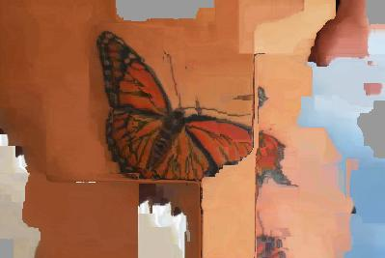
SLS-Flow
Using SIFT-Flow to compute the flow
Left Photo
Right Photo
DSIFT
SID [Kokkinos & Yuille, CVPR’08]
Our SLS

Slide 25
Dense matching with scale differences
Solution 3:
Scale-space sift flow
Previous talk!
W. Qiu, X. Wang, X. Bai, A. Yuille, and Z. Tu, Scale-space sift flow, in Proc. Winter Conf. on Applications of Comput. Vision. IEEE, 2014

Slide 26
Dense matching with scale differences
Solution 4:
Scale propagation
M. Tau, T. Hassner, “Dense Correspondences Across Scenes and Scales”, arXiv:1406.6323 (Available online from: http://arxiv.org/abs/1406.6323) Longer version in submission. Please see http://www.openu.ac.il/home/hassner/publications.html for updates.

Slide 27
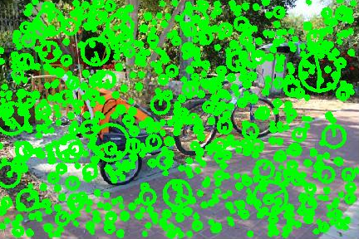
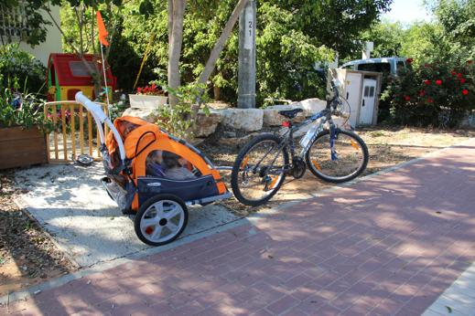
Similar Pixels -> Similar Scales
Only 0.1% of pixels selected by multi-scale feature detector

Slide 28
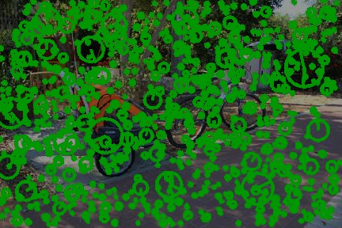
Similar Pixels -> Similar Scales
Scales at neighboring pixels likely to be very similar

Slide 29
Similar Pixels -> Similar Scales
Propagate scales from detected points to neighbors!

Slide 30
Global cost of scale assignment
C$\left(S\right)=\sum_{\text{p}}{{\left(S\left(\text{p}\right)−\sum_{\text{q}∈N\left(\text{p}\right)}{w_{pq}S\left(\text{q}\right)}\right)}^{2}}$
“…the scale at each pixel p should be close to the weighted average of its neighbors q”
Constrained by scales assigned by feature detector
Large, sparse system of equations with efficient solvers

Slide 31
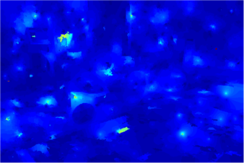
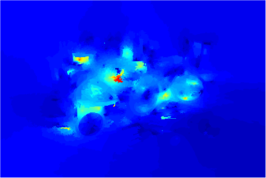
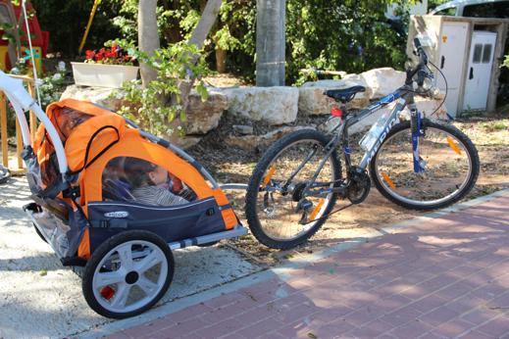
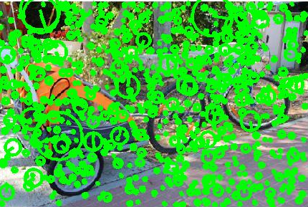
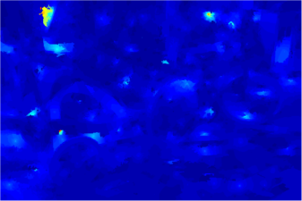
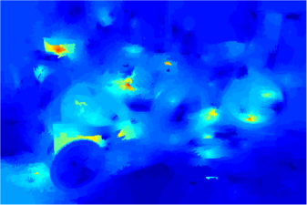
To illustrate
Problem: Many scales do not match
Solution: Propagate scales only from corresponding points!

Slide 32
Space and run-time
Representation | Dim. | SIFT-Flow time

Slide 33
Space and run-time
Representation | Dim. | SIFT-Flow time
DSIFT | 128D | 0.8 sec
SID | 3,328D | 5 sec.
SLS | 8,256D | 13 sec.
Proposed | 128D | 0.8 sec
* Measured on 78 x 52 pixel images
* Propagation required 0.06 sec.

Slide 34
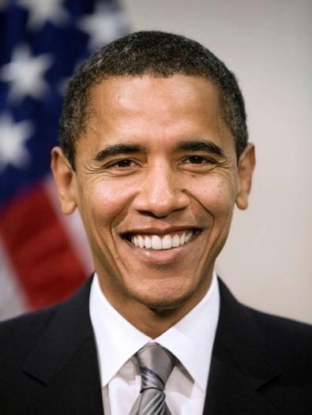
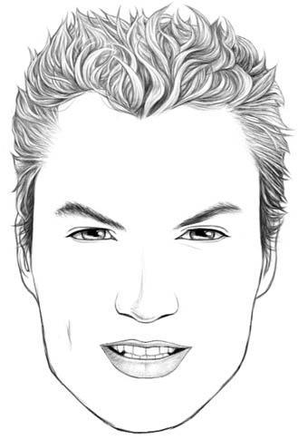
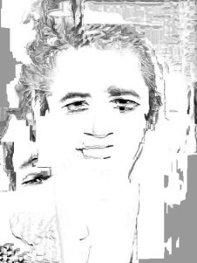
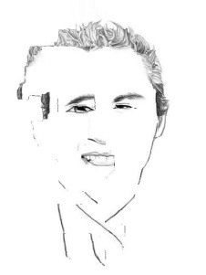
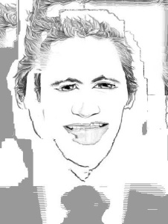
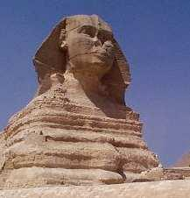
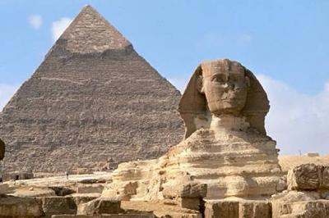
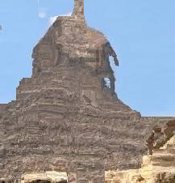
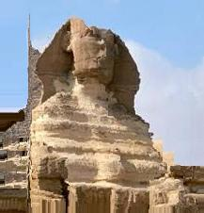
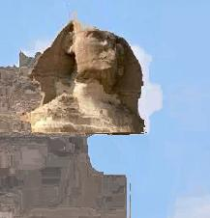
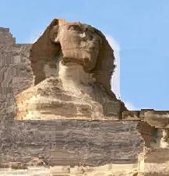
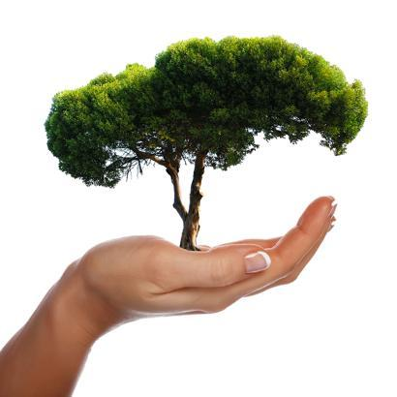
Qualitative
Source
Target
DSIFT
SID
SLS
This

Slide 35
Quantitative
…in the paper
but ~SotA!

Slide 36
What we saw
Dense matching, even when scenes and scales are different

Slide 37
Thank you!
hassner@openu.ac.il
www.openu.ac.il/home/hassner

Slide 38
Some resources
SIFT-Flow
http://people.csail.mit.edu/celiu/SIFTflow/
DSIFT (vlfeat)
http://www.vlfeat.org/
SID
http://vision.mas.ecp.fr/Personnel/iasonas/code.html
SLS
http://www.openu.ac.il/home/hassner/projects/siftscales/
Scale propagation
Code coming soon! (see my webpage for updates)
Me!
http://www.openu.ac.il/home/hassner
hassner@openu.ac.il

