Slide 1
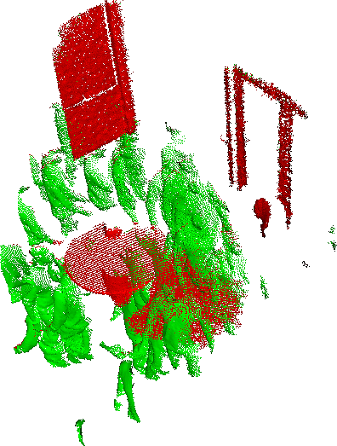
Interactive Learning for Point-Cloud Motion Segmentation
Tal Hassner
The Open University of Israel
The Ninth IEEE Computer Society Workshop on Perceptual Organization in Computer Vision (POCV’14)
Joint work with Yerry Sofer and Andrei Sharf
Paper published as
Y. Sofer, T. Hassner, and A. Sharf, Interactive Learning for Point-Cloud Motion Segmentation, In CGF, vol. 32, no. 7, pp. 51-60. 2013

Slide 2
Input: Dynamic point cloud

Slide 3
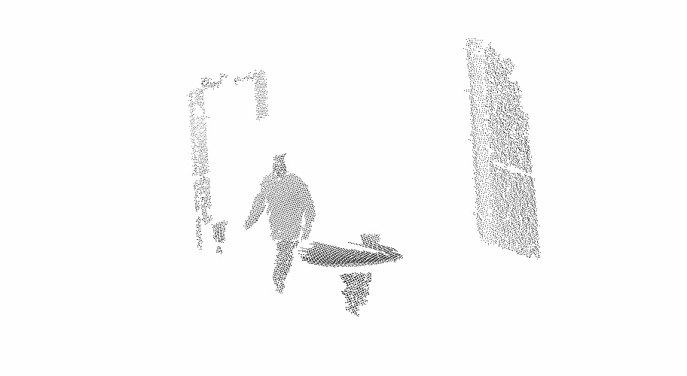
Input: Dynamic point cloud
High-quality 3D sensor(s)
>100k points per frame
Frame number
$$P=\{{(x_{i},y_{i},z_{i},u_{i},v_{i},w_{i},t_{i})}^{T}\}_{i=1}^{N}$$
3D position
normal

Slide 4
Output: Motion segmentation

Slide 5
Why is this hard?

Slide 6
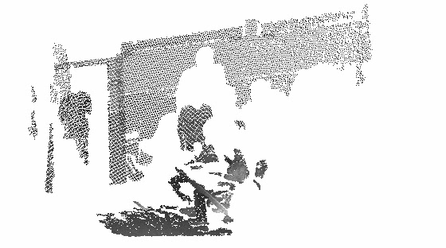
Why is this hard?
Occlusions
Flickering (sample noise)
Spatial proximity of fg to bg
Real-coordinates
Non-uniform sampling
No grid!

Slide 7
FG segmentation “in 3 easy steps”!
Step 1: Coarse segmentation (automatic)
t₂
t₁
Step 2: Adaptive refinement (automatic)
t₂
t₁
Step 3: Interactive fine-tuning (semi-automatic)

Slide 8
Step 1: Coarse segmentation
1. Aggressive random subsampling of points and frame pairs
2. Assign labels using NN criteria
t₂
$$L\left({\text{p}}_{i}\right)=\left\{\begin{matrix}FG & ,\text{if} ∀{\text{p}}_{j}∈F_{t2},dist\left({\text{p}}_{i},{\text{p}}_{j}\right)>θ_{FG} \\ BG & , \text{if} ∃{\text{p}}_{j}∈F_{t2},dist\left({\text{p}}_{i},{\text{p}}_{j}\right)< θ_{BG} \\ UN & , \text{Otherwise}\end{matrix}\right.$$
t₁
$$dist\left({\text{p}}_{i},{\text{p}}_{j}\right)=\left\{\begin{matrix}{\left\|\left(x_{i},y_{i},z_{i}\right),\left(x_{j},y_{j},z_{j}\right)\right\|}_{2} & , \text{if} {\text{n}}_{i}^{T}{\text{n}}_{j}>0.9 \\ θ_{UN} & \text{, }\text{Otherwise}\end{matrix}\right.$$

Slide 9
Step 1: Coarse segmentation
1. Aggressive random subsampling of points and frame pairs
2. Assign labels using NN criteria
3. Train RBF-SVM model using 3D coordinates of labeled points
4. Classify all remaining points

Slide 10
Step 1: Coarse segmentation
…but what about these???
1. Aggressive random subsampling of points and frame pairs
2. Assign labels using NN criteria
3. Train RBF-SVM model using 3D coordinates of labeled points
4. Classify all remaining points

Slide 11
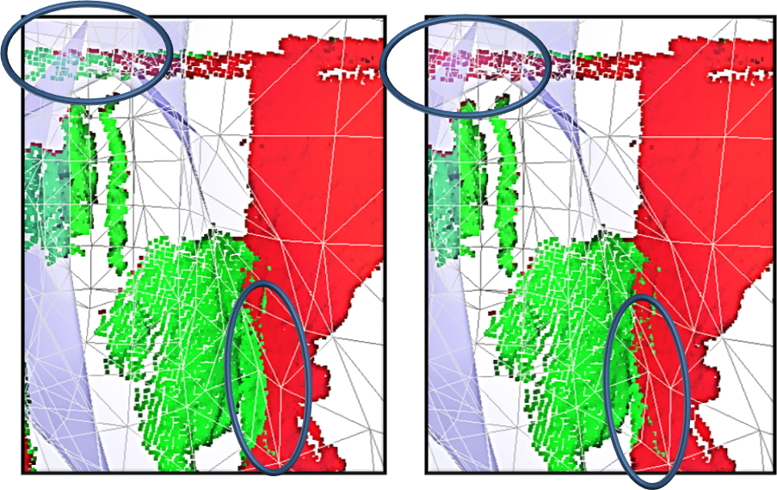
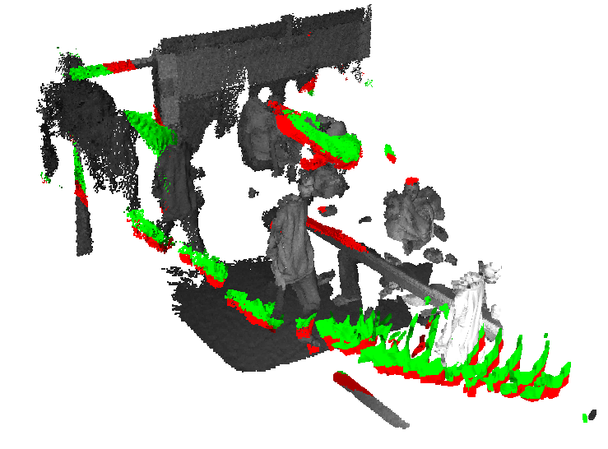
Step 2: Adaptive refinement
t₂
1. Automatically detected unreliable segmentation areas
t₁
2. Sample more points from these areas and label them using NN criteria
Re-train RBF-SVM classifier
Classify all points with new classifier

Slide 12
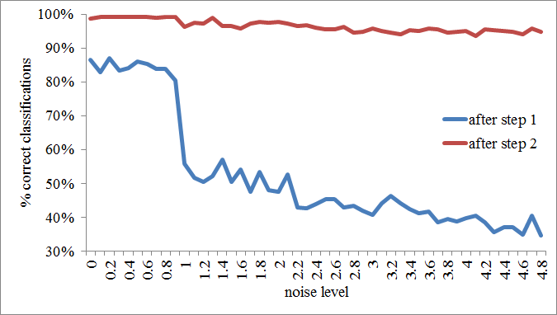
Robustness of the 2-step process
After initial segmentation
Sampling noise
After automatic refinement

Slide 13
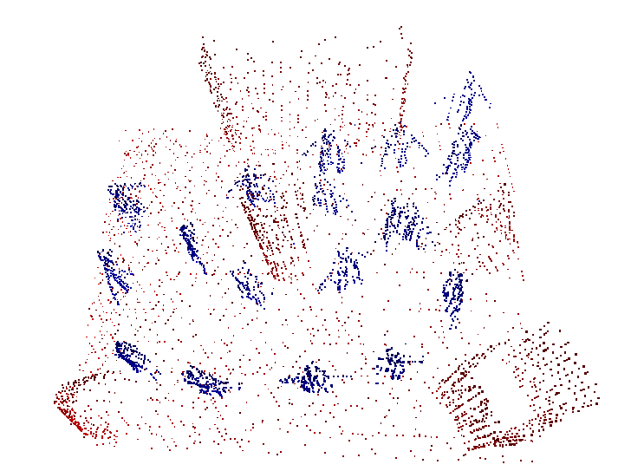
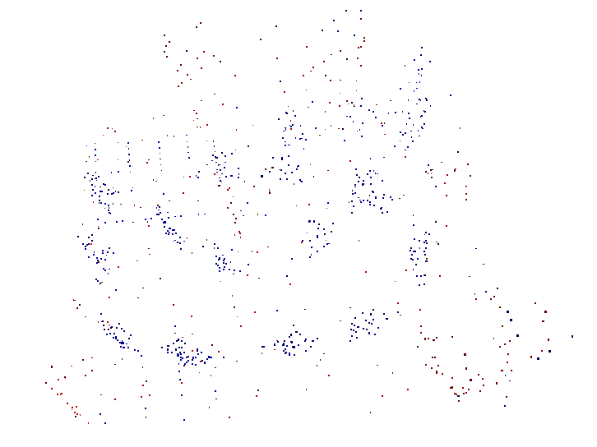
Robustness of the 2-step process
Point Sampling rate

Slide 14
Step 3: Manual refinement
Correcting for segmentation errors?

Slide 15
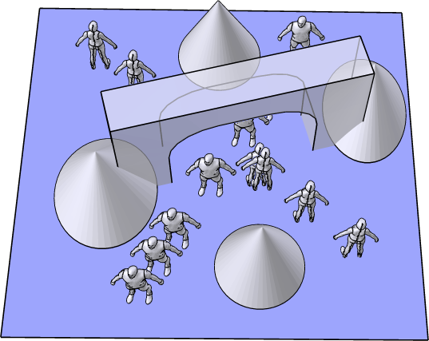
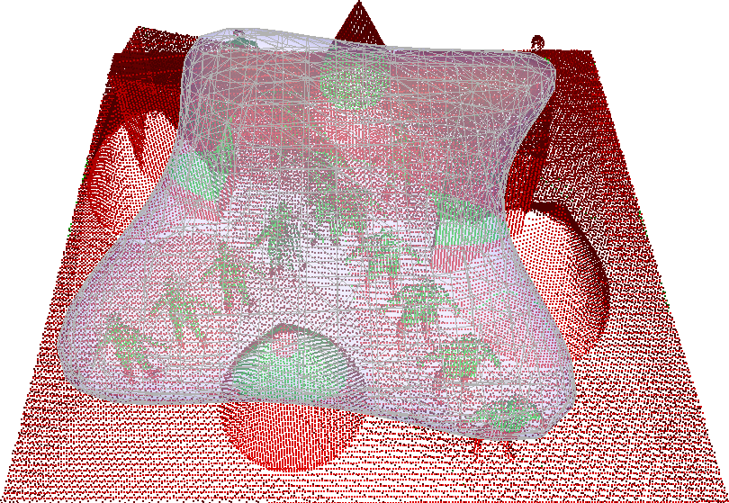
Step 3: Manual refinement
Observation:
RBF-SVM classifiers have geometric interpretations

Slide 16
Step 3: Manual refinement
1. Visualize decision border (marching cubes [BLOOMENTHAL’94])
2. Manually drag the decision border surface (local thin plate spline [DONATO & BELONGIE’02])
3. Create dummy positive / negative examples from surface nodes
4. Re-train RBF-SVM with new training, and apply to entire scene

Slide 17
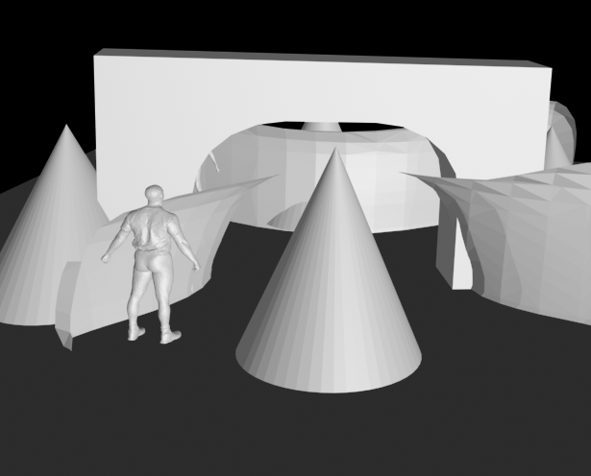
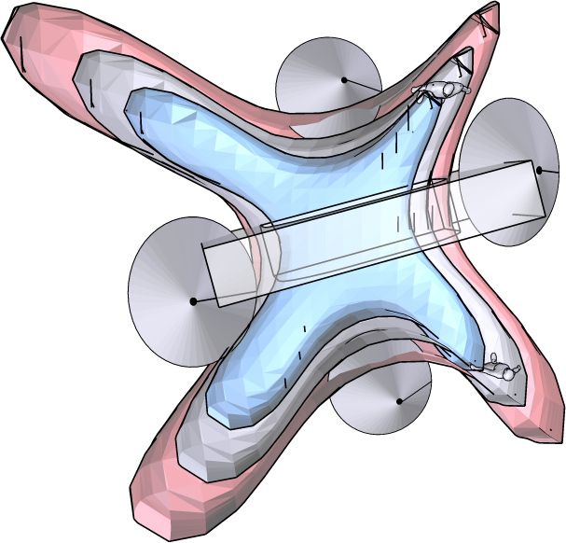
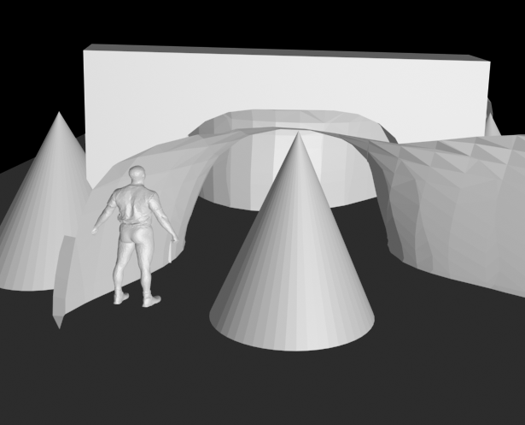
Step 3: Manual refinement

Slide 18
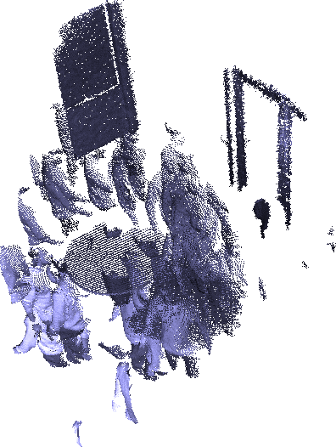
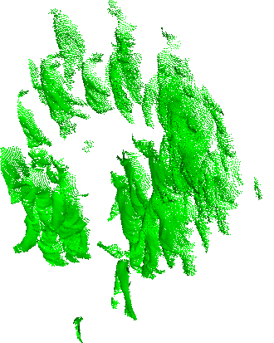
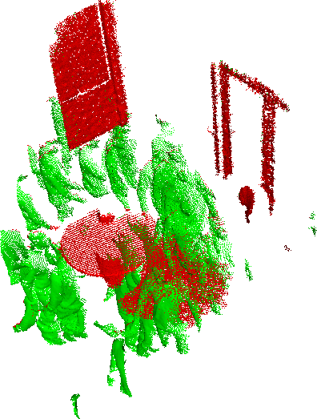
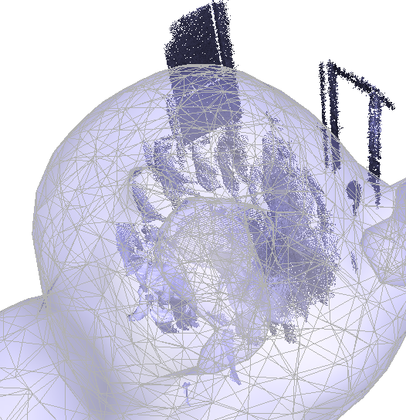
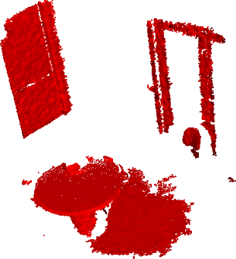
Results: real-world scans
foreground
Input
background
Fg+bg superimposed
Editable decision border

Slide 19
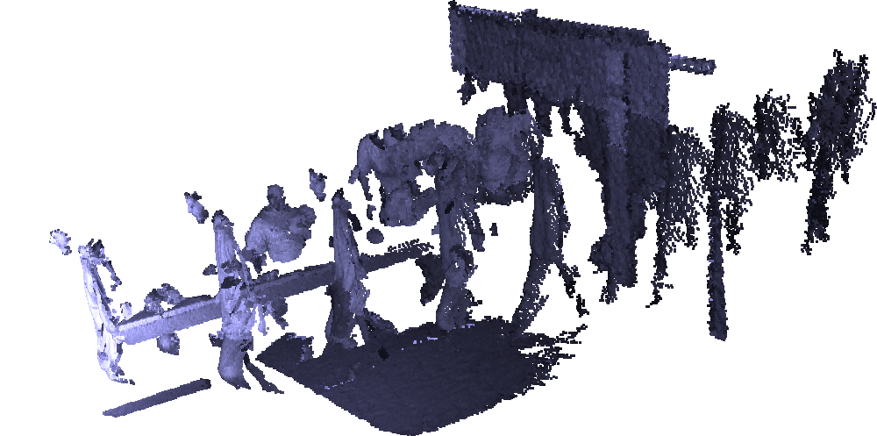
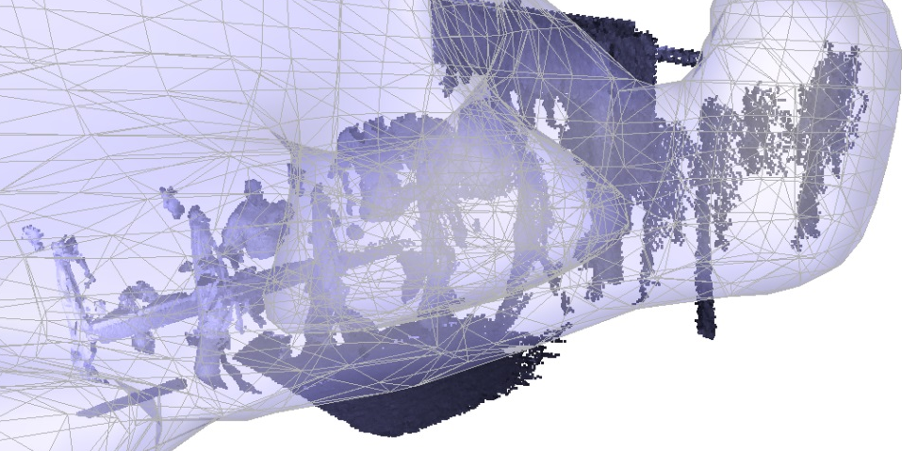
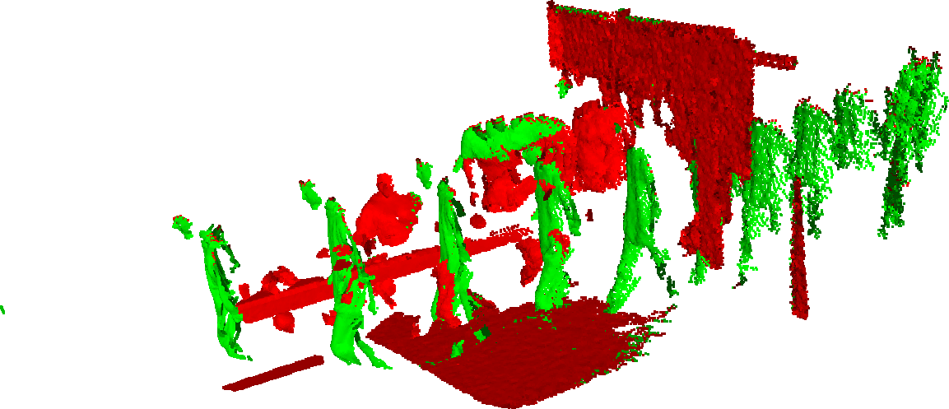
Results: real-world scans
Input
Editable decision border
Fg+bg superimposed

Slide 20
Take home message
Motion segmentation of
3D
noisy
Real-valued
Non-uniform
Point-cloud data
CG+ML = Editable SVM-RBF classifiers!

Slide 21
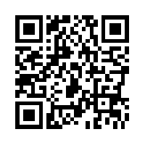
Thank you!
http://www.openu.ac.il/home/hassner/
hassner@openu.ac.il

