Slide 1
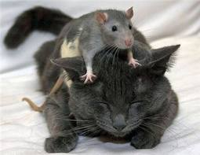
The role of CD44 in response to stress
Life Science Research Project
Rea Globus
B.Sc. student, The Open University of Israel
Laboratory: The Neuroscience Lab, Felsenstein Medical Research Center, Tel-Aviv University, Israel
Head of lab: Professor Daniel Offen, PhD
Investigator leading the research: Ran Barzilay, MD PhD
Open University assigned instructor : Professor Anat Barnea, PhD

Slide 2
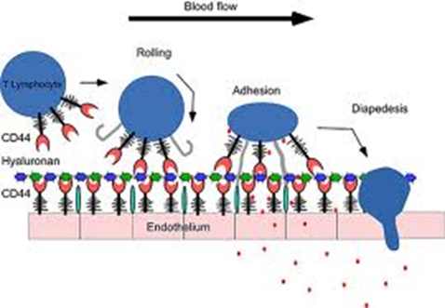
CD44 molecule
Cell adhesion
Cell migration
CD44 plays a role in various inflammatory processes:
  Receptor for hyaluronic acid but also osteopontin, collagens, and matrix metalloproteinases
  In the brain, CD44 is expressed in astrocytes, microglia and neuronal stem cells

Slide 3
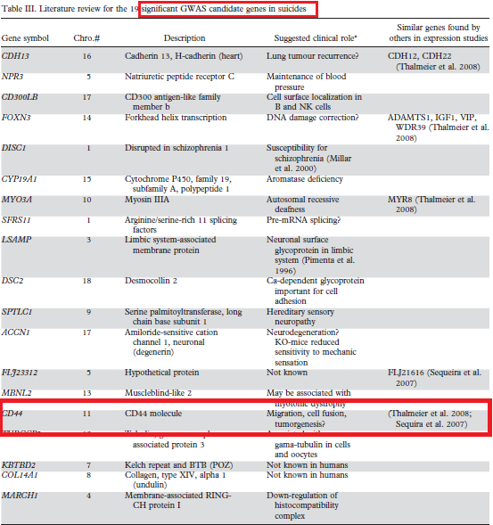
CD44 and depression
Galfalvy, H. et al. A pilot genome wide association and gene expression array study of suicide with and without major depression. The world journal of biological psychiatry : the official journal of the World Federation of Societies of Biological Psychiatry 1–9 (2011).doi:10.3109/15622975.2011.597875

Slide 4
CD44 and depression
Galfalvy, H. et al. A pilot genome wide association and gene expression array study of suicide with and without major depression. The world journal of biological psychiatry : the official journal of the World Federation of Societies of Biological Psychiatry 1–9 (2011).doi:10.3109/15622975.2011.597875
CD44 play a key role in inflammatory processes
Under conditions of physiological and cell-culture stress, expressions of CD44 cell surface molecule is inhibited
Disordered neuro-immune function may be present in suicide and have its pathogenesis related to these genes

Slide 5
Hypothesis
Cell adhesion and cell migration are important to sustain the functional state of CNS
Recent studies identified deregulation of CD44 in the cerebrospinal fluid of depressed patients and as a possible candidate gene for suicidal behavior

Slide 6
Hypothesis
CD44 knockout mice (CD44KO) under chronic stress will show less resilience
CD44KO will display a different behavioral phenotype in terms of depressive-like and anxiety-like behavior (under challenge)

Slide 7

Experimental Design
Total n=60
Males
Wild-type n=24
CD44 KO n=36
CMS n=13
Control n=11
CMS n=19
Control n=17
General illustration of the experimental design

Slide 8
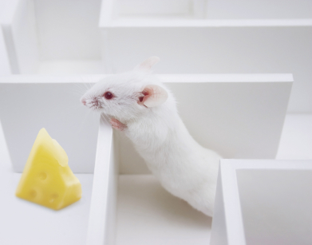
MEthods

Slide 9
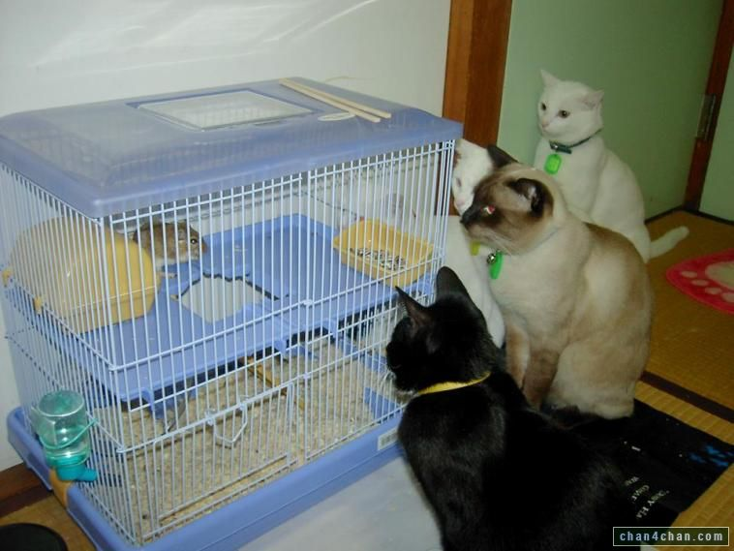
CMS
subjecting 'normal' mice to a series of repeated physical stresses over a period of weeks or longer
There are different kinds of stressors such as: cage tilting, white noise, placement in a empty cage and etc
Some stressors are used only at a specific week & time period (other than repeatedly) due to mice's tendency to 'expect' the stressors and therefore they are less effective

Slide 10
Behavioral Tests
All behavioral tests were conducted using the Noldus XT EthoVision platform which allows automated measurement and analysis
Tests were conducted at the following order : Forced Swim Test (FST), Open Field (OF), Novel object Recognition Test (NORT), Elevated Plus Maze (EPM), social preference test(data not shown)

Slide 11
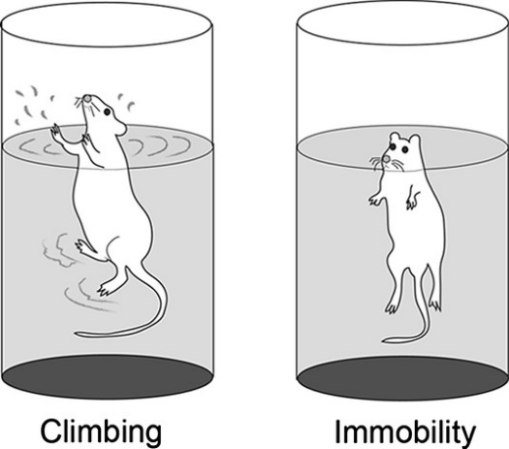
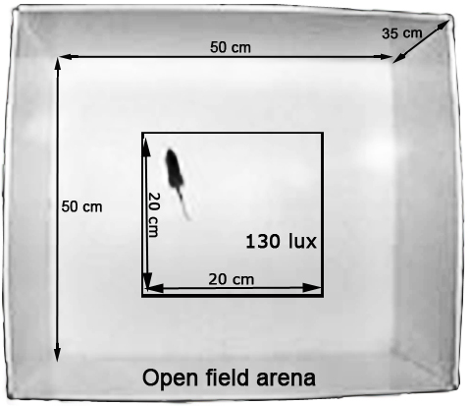
Behavioral Tests – FST & OF
FST- mice are subjected to an acute, short-duration (minutes) stress and the time during which they respond actively versus passively, is measured to assess locomotor and depression like activity
OF – the mice were put in an arena for 60 minutes in order to asses variations in mobility

Slide 12
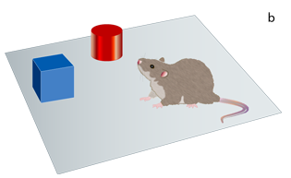
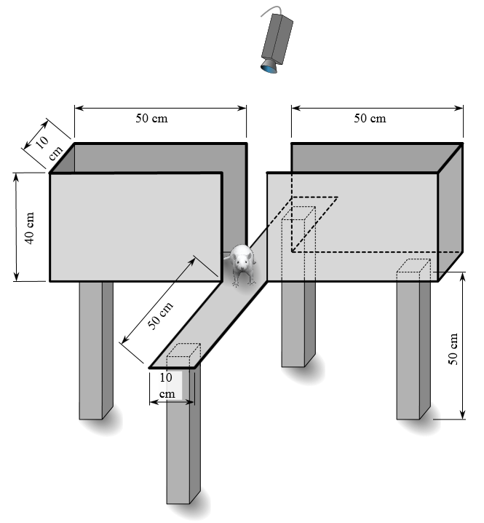
Behavioral Tests – NORT & EPM
NORT- tests the ability of mice to recognize a novel object in an otherwise familiar environment to assess object memory. If the exploration of the novel and the familiar object is equal, this can be interpreted as a memory deficit
EPM – exploits the balance between the preference of mice for avoiding open exposure to predators (the open arms of the) versus exploration for possible rewards and curiosity which motivates them to explore the compartment

Slide 13
RESULTS

Slide 14
Depressive/desperate- like behavior as observed in the forced swim test
Results represent the time in which the animal spent floating ,as opposed to climbing behavior, over the last 5 minutes of the test
Exposure to CMS did not significantly affect the behavior in the forced swim test in both the WT+CMS group compared to WT
Bars represent the mean+ - SEM. *p<0.05, **p<0.01, ***p<0.001

Slide 15
Anxiety- like behavior as observed in the elevated plus maze
significant strong effect on anxiety levels in the CD44KO mice
CD44KO mice which underwent CMS spent significantly less time in the open arms compared to all other experimental groups
CD44KO+CMS mice spent about 70 % less time in the open arms compared to the mice which did not undergo CMS
Bars represent the mean+ - SEM. *p<0.05, **p<0.01, ***p<0.001

Slide 16
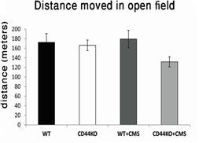
Distance moved in the open field test
As a measure of motor behavior mice were put in the open field arena for 60 minutes and their total distance moved was recorded
No differences were revealed between the four experimental groups WT, KO, WT+CMS and KO+CMS
Bars represent the mean+ - SEM. *p<0.05, **p<0.01, ***p<0.001

Slide 17
discussion

Slide 18
Discussion
Interestingly in the forced swim test, we found that the CMS was not relevant
The fact that CD44KO mice showed increased floating time(despair-like behavior) in the forced swim test compared to WT independent to CMS, may suggest that CD44KO mice have impaired capacity to cope with the acute stress of the forced swim test.
In contrast, CD44KO and WT mice which were previously exposed to CMS were “primed” to cope with such acute stressor, resulting in adequate behavior in the forced swim test

Slide 19
Discussion
Decreased time spent in the open arm of the elevated plus maze (anxious-like behavior) more than 2 weeks after the end of the imposed stress.
Since this test imposes relatively minor acute stress on the test mouse, it allows the mouse to display “natural” response, namely increased anxious response in both the WT and the CD44KO groups who underwent CMS, but to a larger extent in the CD44KO+CMS experimental group, indicating the higher vulnerability of CD44KO mice to stress.

Slide 20
CD44KO mice are more susceptible to stress
Taken together, the extensive behavioral data indicate that lack of CD44 protein results in increased susceptibility to stress both in the short (impaired coping in the forced swim test) and in the long term (increased anxiety in the EPM more than two weeks after CMS)

Slide 21
Summary
Adhesion molecules were previously linked to the response to mental stress in mice and humans, we chose to focus on CD44
CD44 is involved in orchestrating stress response in mice as observed in various behavioral endophenotypes
CD44 signaling may be considered as a possible biomarker for “mental stressful states”
CD44 signaling pathway might be considered as a target for intervention in psychopathologies involving compromised response to stress

Slide 22
THANKS
Professor Dani Offen, PhD – Head, the Neuroscience Lab
Ran Barzily MD PhD – Investigator leading the project
Professor Anat Barnea – Open University assigned instructor

