Slide 1
Stereoselective Halogenation of Alcohols using Nonsymmetric Thioureas
Research project
Artiom Ponomariov
Supervisors
Prof. Ofer Reany and Prof. N. Gabriel Lemcoff

Slide 2
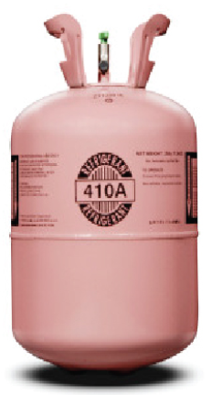
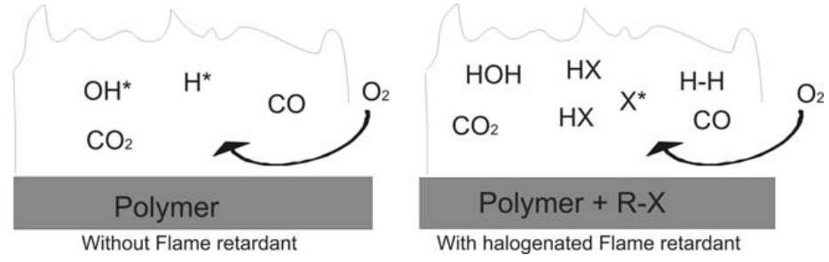
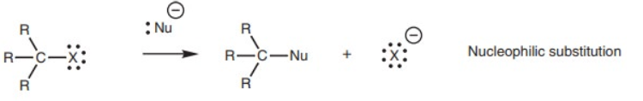
Introduction
The industrial usefulness of alkyl halides
  Common uses include flame retardants where halides eliminate free radicals
  Halocarbons offer a safe cheap refrigerant while having a low boiling point allowing good heat absorption
Beneficial chemical properties of the C-X bond
  The nature of the halide as an excellent leaving group opens diverse synthetic possibilities.
  Polarizability of the halides increases the electrophilicity of the carbon atom.
Source: 1. Brominated flame retardants and their metabolites, 2008, Utrecht University.
2. R410A, sold under the trademarked Puron.
Notes:
DDT – colorless, tasteless and almost odorless crystalline organochloride used as an insecticide, synthesized in 1874,
Bromine (Br), fluorine (F), chlorine (Cl) and iodine (I) are effective in eliminating free radicals (e.g. H* or OH*) and thereby reducing the capability of the flame to propagate
Puron is a mixture of CH2F2 and CHF2CF3 used as a refrigerant in air conditioning applications

Slide 3


Introduction
Today’s environmental problem of manufacturing alkyl halides from petrochemicals contributes to the green house effect, acidic rains and biomass depletion from the soil
Halogenation of naturally occurring alcohols provides an alternative source for halocarbons without the pollution involved in petrochemicals.
Source: Adsorbable organic halogens in contaminated water environment: A review of sources and removal technologies,
2021, Journal of Cleaner Production.
Notes:
Many of the substrates used to create alkyl halides come from the petrochemical industries after refining crude oil and natural gas, this creates multiple environmental problems, including but not limited to the ‘green house’ effect, acidic rains but most importantly – oil is a finite, non-regenerative resource.
Most commercially available alcohols are naturally occurring substrates, such as menthol, cholesterol, etc., or obtained through simple nonpolluting methods such as fermentation and distillation.

Slide 4
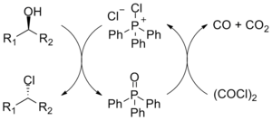

Background
Classical methods of alcohol halogenation
  The S_{N}x reaction - the substituted group is affected depending on the number of substituents on the α-carbon
  The Appel reaction – conversion of an alcohol to alkyl halide using triphenylphospine and a halide source
Source: Atom Economy, Nagwa.
Notes:
Traditionally, the halogenation of alcohols is performed using strong acids
Drawbacks to the Appel reaction are the use of toxic halogenating agents and the coproduction of organophosphorus product that must be separated from the organic product

Slide 5
Background
A new method was discovered - dimethyl thiourea mediated halogenation of alcohols
Dimethyl thiourea converts alcohols into organic halides using stoichiometric amounts of thiourea derivatives and NXS (X= Br, Cl) as the halogen source
Using this method under ambient conditions it was possible to halogenate primary, secondary and tertiary alcohols, while maintaining atomic efficiency by recovering the succinimide by-product, i.e the halogen source.
Source: Thiourea-Mediated Halogenation of Alcohols, 2020, Journal of Organic Chemistry.

Slide 6
Research question
Is it possible to influence the halogenation mechanism to control the stereoselectivity of the reaction by using asymmetric thioureas?
Source: Thiourea-Mediated Halogenation of Alcohols, 2020, Journal of Organic Chemistry.

Slide 7
Methodology
We will use different thioureas with increasing side group bulkiness to examine if there is a retention or inversion of configuration on the product
We will also test different cyclical alcohols with ortho, para and meta substituents to determine if steric hindrance plays a role in the reaction mechanism.

Slide 8
Results - Halogenation of (-)-Menthol
Testing (-)-menthol using NBS and thioureas with increasing bulk side group (marked R) produced the desired product as the main product in the mixture
In addition to the desired product, we discovered multiple brominations on the molecule
Due to the high number of products with similar polarity there was no option to explore stereoselectivity using TLC and silica column separation
Thiourea side groups reduce desired product yield as shown in the graph, measuring our desired product yield

Slide 9
Results
Testing 3-cis- and 4-cis\trans-methyl cyclohexanol using NBS and thioureas with increasing bulk side group (marked R) produced the desired product as the lesser product in the mixture
In addition to the desired product, we discovered multiple brominations on the molecule
Larger substituents on thiourea resulted in decreased bromination, same as with menthol.
The position of methyl group on the cyclohexyl ring did not affect the outcome yield of the desired product.

Slide 10
Findings
Thiourea side group bulkiness decreased reaction efficiency in all reactions
NBS serves as an oxidant – while performing the reaction using wise addition we observed no oxidation in our products.
DMTU Gaussian behavior is observed in (-)-menthol – The ratio of product to DMTU to NBS is paramount for the reaction to move forward in an efficient manner

Slide 11
Conclusions
Further optimization of the reaction is possible until an adequate yield is achieved through adjustment of the reactant : NBS : DMTU ratio
Premixing the reactant with DMTU and using wise addition of NBS shows a promising solution to remove oxidation products
Due to the multiple by-products in the reaction mixture from the bromination on top of our desired product, TLC & column separation methods have no use until better yield is achieved and oxidation products are eliminated
6 carbon cyclical compounds with the –OH group attached to the ring share similar product results but with varying yields. The heavily substituted (-)-menthol showed across all tests a greater yield then the less substituted x-methyl-cyclohexanol (x=2,3,4).
Notes:
While not as straight forward as their a-cyclical counterparts, cyclical alcohols present an interesting challenge and prospective

Slide 12
Further tests are required
Optimizing the (-)-menthol reaction by adjusting the NBS:DMTU ratio represents a promising step towards utilizing cyclical reactants for DMTU mediated halogenation
NBS addition in fractions over a set amount of time showed no oxidation products in the reaction, testing with different starting materials and an optimized NBS:DMTU ratio should yield better results for the single halogenation reaction we are after.
After optimization and removal of the oxidation products, it should be possible to isolate the desired product to run NMR analysis for stereoselectivity ratio determination.

Slide 13
Acknowledgments

