Slide 1
Scale-less Dense Correspondences
Tal Hassner
The Open University of Israel
ICCV’13 Tutorial on
Dense Image Correspondences for Computer Vision

Slide 2
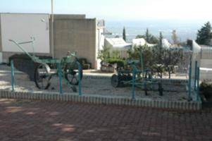
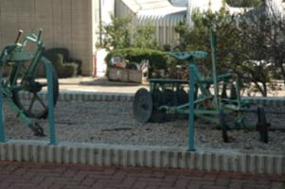
Matching Pixels
In different views, scales, scenes, etc.
Invariant detectors + robust descriptors + matching

Slide 3
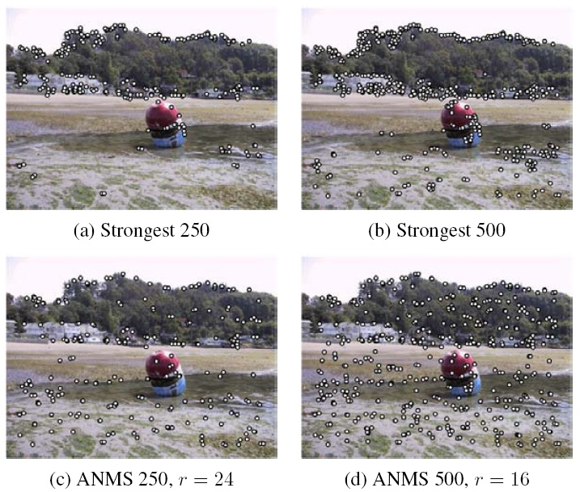
Observation:
Invariant detectors require dominant scales
BUT
Most pixels do not have such scales
[Szeliski’s book]

Slide 4
Observation:
Invariant detectors require dominant scales BUT Most pixels do not have such scales
But what happens if we want dense matches with scale differences?
[Szeliski’s book]

Slide 5
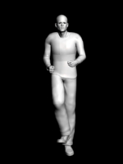
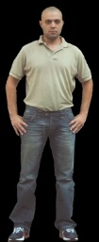
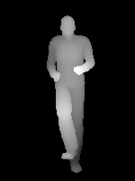
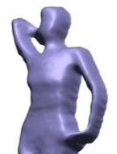
Shape by-example
[Hassner&Basri ’06a, ‘06b,’13]
Why is this useful?

Slide 6
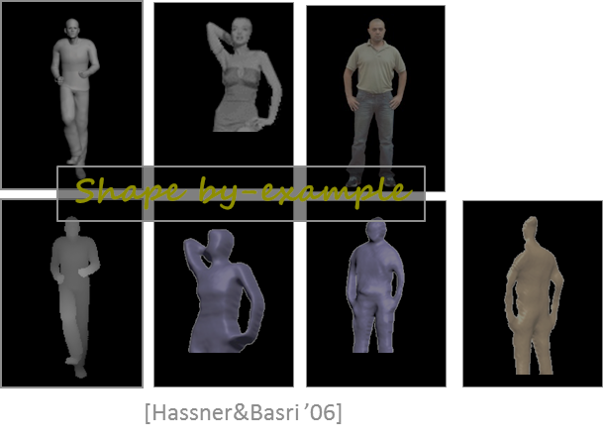
Why is this useful?
[Liu, Yuen & Torralba ’11; Rubinstein, Liu & Freeman’ 12 ]
Label transfer / scene parsing

Slide 7
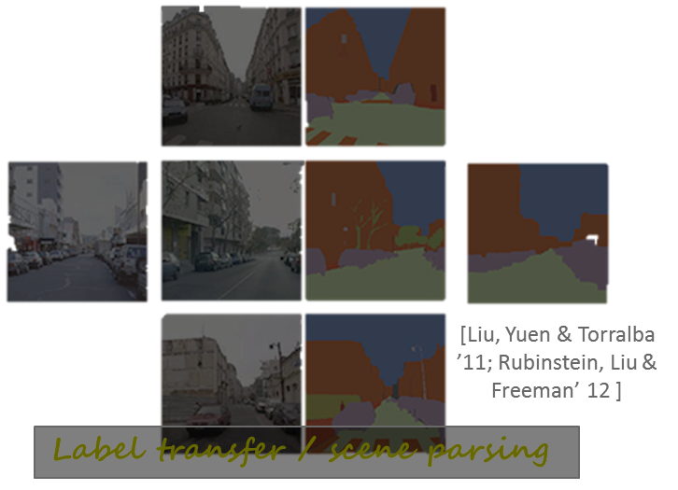
Why is this useful?
Depth transfer
…
[Karsch, Liu & Kang ’12]

Slide 8
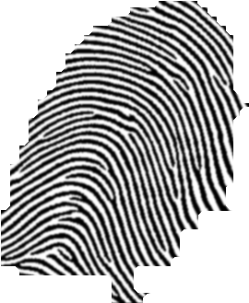
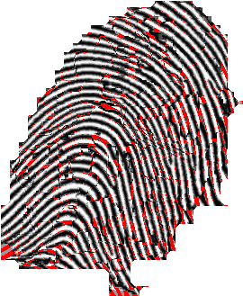
Face recognition
[Liu, Yuen & Torralba ’11]
Fingerprint recognition
Why is this useful?
[Hassner, Saban & Wolf]

Slide 9
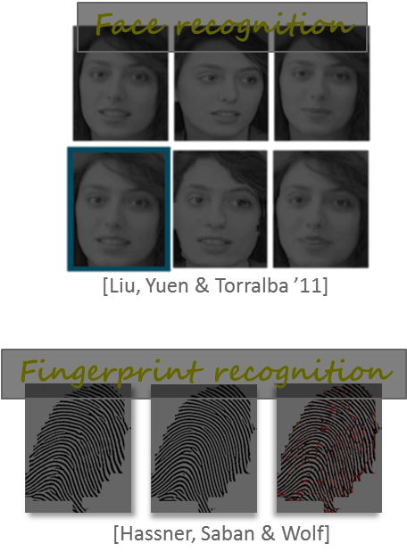
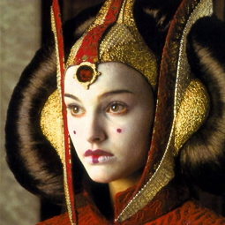
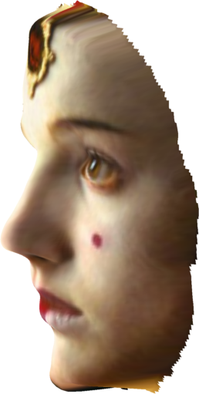
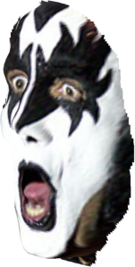
New view synthesis
[Hassner ‘13]
Why is this useful?

Slide 10
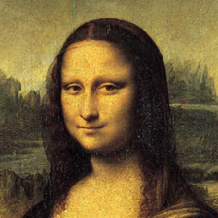
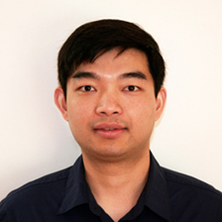
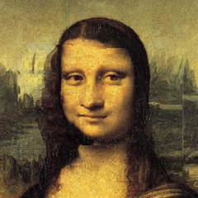
Ce Liu transfer!
Why is this useful?

Slide 11
Dense matching with scale differences
Solution 1:
Ignore scale differences – Dense-SIFT

Slide 12
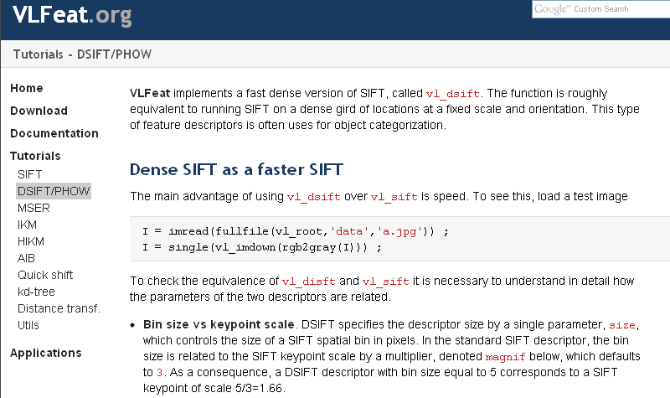
Dense SIFT (DSIFT)
Arbitrary scale selection
[Vedaldi and Fulkerson‘10]

Slide 13
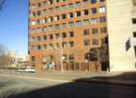
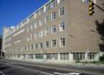
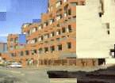
SIFT-Flow
[Liu et al. ECCV’08, PAMI’11]
Left photo
Right photo
Left warped onto Right
“The good”: Dense flow between different scenes!

Slide 14
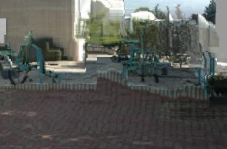
SIFT-Flow
[Liu et al. ECCV’08, PAMI’11]
Left photo
Right photo
Left warped onto Right
“The bad”: Fails when matching different scales

Slide 15
Dense matching with scale differences
Solution 2:
Scale Invariant Descriptors (SID)*
* Kokkinos and Yuille, Scale Invariance without Scale Selection, IEEE Conf. on Computer Vision and Pattern Recognition (CVPR), 2008

Slide 16
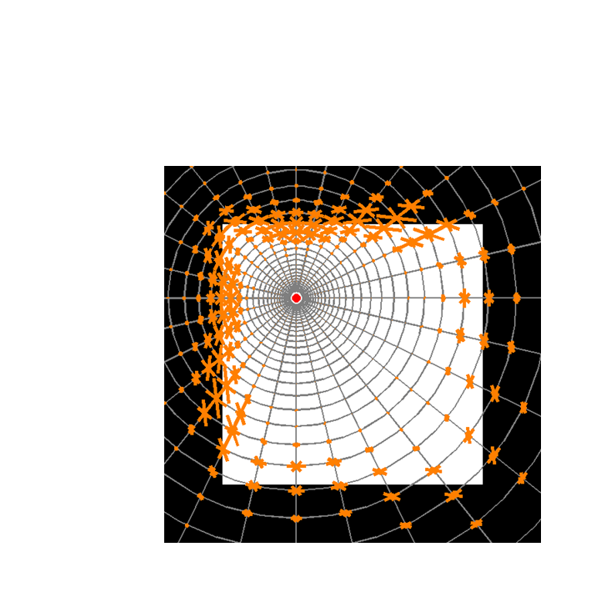
Log-Polar sampling
$$r$$
$$θ$$

Slide 17
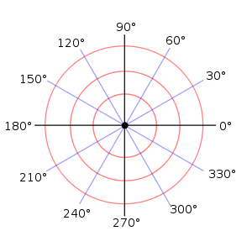
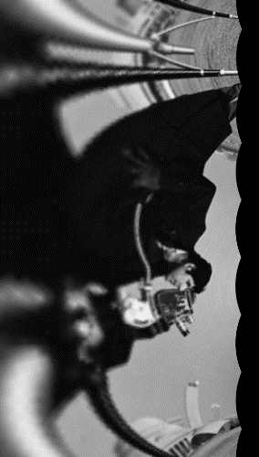
From Rotation + Scale to translation
$$r$$
$$θ$$
$$r$$
$$θ$$
$$r$$
$$θ$$

Slide 18
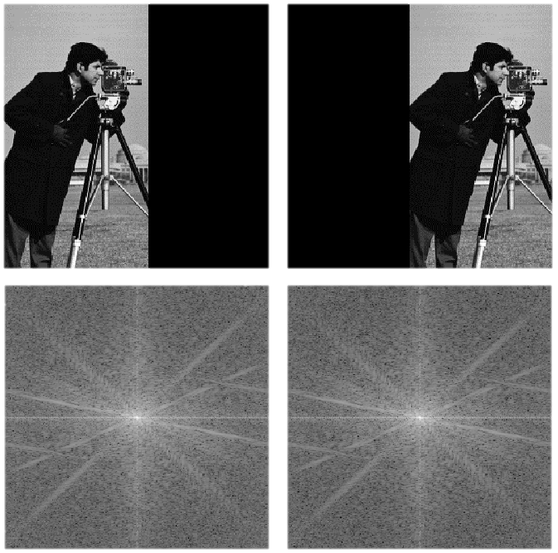
Translation invariance
Absolute of the Discrete-Time Fourier Transform

Slide 19
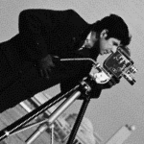
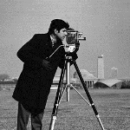
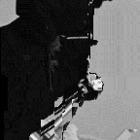
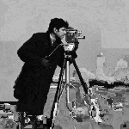
SID-Flow
Left
Right
DSIFT
SID

Slide 20
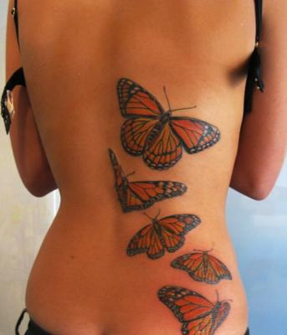
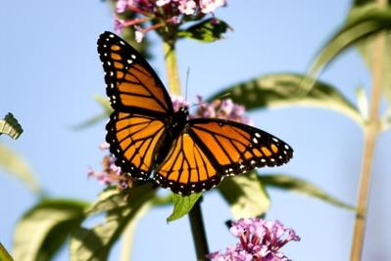
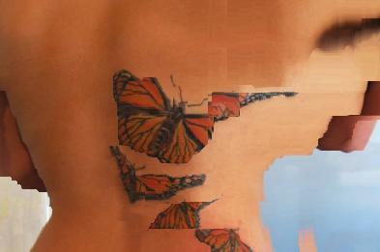
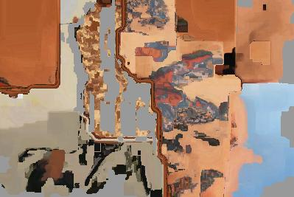
SID-Flow
Left
Right
DSIFT
SID

Slide 21
Dense matching with scale differences
Solution 3:
Scale-Less SIFT (SLS)*
Joint work with Viki Mayzels and Lihi Zelnik-Manor and
* T. Hassner, V. Mayzels, and L. Zelnik-Manor, On SIFTs and their Scales, IEEE Conf. on Computer Vision and Pattern Recognition (CVPR), Rhode Island, June 2012

Slide 22
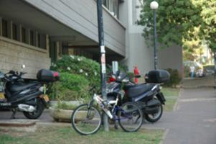
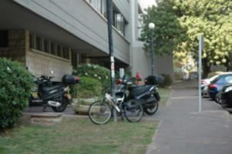
SIFTs and Multiple Scales

Slide 23
SIFTs and Multiple Scales

Slide 24
Observation 1
Corresponding points have multiple SIFT matches at multiple scales

Slide 25
2
4
6
8
10
Left image SIFTs
12
14
16
18
20
22
24
2
4
6
8
10
12
14
16
18
20
22
24
Right image SIFTs

Slide 26
Matching ver.1
Use set-to-set distance:

Slide 27
To Illustrate
…if SIFTs were 2D

Slide 28
Observation 2
SIFT changes gradually across scales
Suggests they reside on manifold

Slide 29
Main Assumption
SIFTs in multi-scales lie close to a linear subspace
Fixed local statistics :
Gradual changes across scales:
basis

Slide 30
So, for each pixel…
Extract SIFTs at multi-scales
Compute basis (e.g., PCA)
This low-dim subspace reflects SIFT behavior through scales

Slide 31
Matching ver.2
Use subspace to subspace distance:

Slide 32
To Illustrate
θ

Slide 33
The Scale-Less SIFT (SLS)
Map these subspaces to points!
[Basri, Hassner, Zelnik-Manor, CVPR’07, ICCVw’09, TPAMI’11]
For each pixel p

Slide 34
The Scale-Less SIFT (SLS)
Map these subspaces to points!
[Basri, Hassner, Zelnik-Manor, CVPR’07, ICCVw’09, TPAMI’11]
A point representation for the subspace spanning SIFT’s behavior in scales!!!
For each pixel p

Slide 35
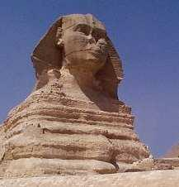
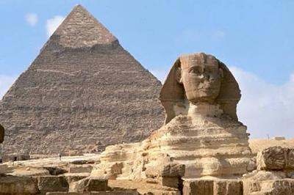
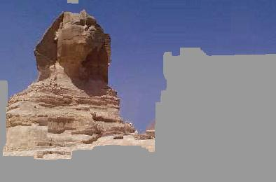
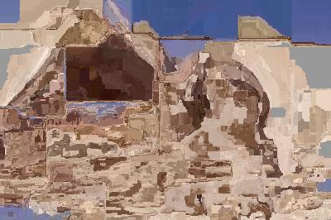
SLS-Flow
Left Photo
Right Photo
DSIFT
SID [Kokkinos & Yuille, CVPR’08]
Our SLS

Slide 36
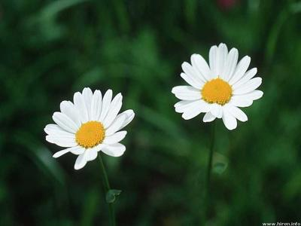
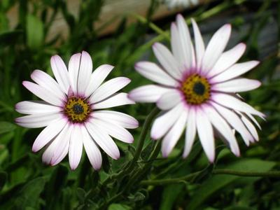
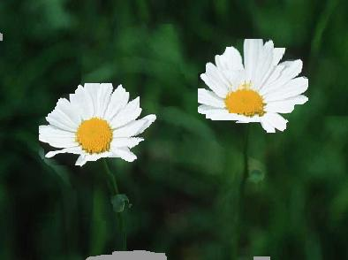
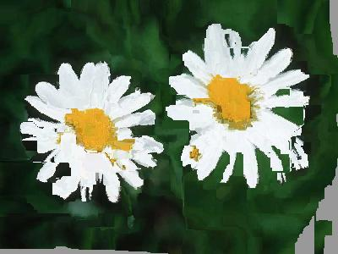
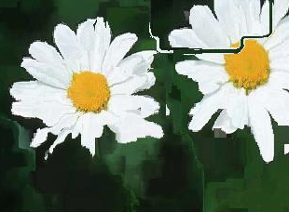
Dense-Flow with SLS
Using SIFT-Flow to compute the flow
Left Photo
Right Photo
DSIFT
SID [Kokkinos & Yuille, CVPR’08]
Our SLS

Slide 37
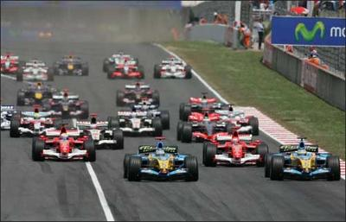
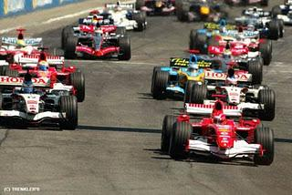
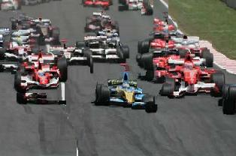
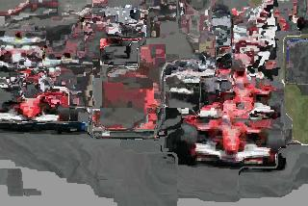
Dense-Flow with SLS
Using SIFT-Flow to compute the flow
Left Photo
Right Photo
DSIFT
SID [Kokkinos & Yuille, CVPR’08]
Our SLS

Slide 38
What we saw
Dense matching, even when scenes and scales are different

Slide 39
Thank you!
hassner@openu.ac.il
www.openu.ac.il/home/hassner

Slide 40
References
[Basri, Hassner & Zelnik-Manor ’07] Basri, Ronen, Tal Hassner, and Lihi Zelnik-Manor. "Approximate nearest subspace search with applications to pattern recognition." Computer Vision and Pattern Recognition, 2007. CVPR'07. IEEE Conference on. IEEE, 2007.
[Basri, Hassner, Zelnik-Manor ’09] Basri, Ronen, Tal Hassner, and Lihi Zelnik-Manor. "A general framework for approximate nearest subspace search." Computer Vision Workshops (ICCV Workshops), 2009 IEEE 12th International Conference on. IEEE, 2009.
[Basri, Hassner, Zelnik-Manor ’11] Basri, Ronen, Tal Hassner, and Lihi Zelnik-Manor. "Approximate nearest subspace search." Pattern Analysis and Machine Intelligence, IEEE Transactions on 33.2 (2011): 266-278.
[Hassner ’13] Hassner, Tal. "Viewing real-world faces in 3D." ICCV, 2013.
[Hassner & Basri ’06a] Hassner, Tal, and Ronen Basri. "Example based 3D reconstruction from single 2D images." Computer Vision and Pattern Recognition Workshop, 2006. CVPRW'06. Conference on. IEEE, 2006.
[Hassner & Basri ’06b] Hassner, T., and R. Basri. "Automatic depth-map colorization." Proc. Conf. Eurographics. Vol. 2006. 2006.
[Hassner & Basri ’13] Hassner, Tal, and Ronen Basri. "Single View Depth Estimation from Examples." arXiv preprint arXiv:1304.3915 (2013).
[Hassner, Mayzels & Zelnik-Manor’12] Hassner, Tal, Viki Mayzels, and Lihi Zelnik-Manor. "On sifts and their scales." Computer Vision and Pattern Recognition (CVPR), 2012 IEEE Conference on. IEEE, 2012.
[Hassner, Saban & Wolf] Hassner, Tal, , Gilad Saban, and Lior Wolf, In submission
[Karsch, Liu & Kang] Karsch, Kevin, Ce Liu, and Sing Bing Kang. "Depth extraction from video using non-parametric sampling." Computer Vision–ECCV 2012. Springer Berlin Heidelberg, 2012. 775-788.
[Kokkinos & Yuille’08] Kokkinos, Iasonas, and Alan Yuille. "Scale invariance without scale selection." Computer Vision and Pattern Recognition, 2008. CVPR 2008. IEEE Conference on. IEEE, 2008.
[Liu, Ce, et al.’08] Liu, Ce, Jenny Yuen, Antonio Torralba, Josef Sivic, and William T. Freeman. "SIFT flow: dense correspondence across different scenes." Computer Vision–ECCV 2008. Springer Berlin Heidelberg, 2008. 28-42.
[Liu, Yuen & Torralba’ 11] Liu, Ce, Jenny Yuen, and Antonio Torralba. "Sift flow: Dense correspondence across scenes and its applications." Pattern Analysis and Machine Intelligence, IEEE Transactions on 33.5 (2011): 978-994.
[Rubinstein, Liu & Freeman’12] Rubinstein, Michael, Ce Liu, and William T. Freeman. "Annotation propagation in large image databases via dense image correspondence." Computer Vision–ECCV 2012. Springer Berlin Heidelberg, 2012. 85-99.
[Szeliski’s book] Szeliski, Richard. Computer vision: algorithms and applications. Springer, 2011.
[Vedaldi and Fulkerson’10] Vedaldi, Andrea, and Brian Fulkerson. "VLFeat: An open and portable library of computer vision algorithms." Proceedings of the international conference on Multimedia. ACM, 2010.

Slide 41
Resources
SIFT-Flow
http://people.csail.mit.edu/celiu/SIFTflow/
DSIFT (vlfeat)
http://www.vlfeat.org/
SID
http://vision.mas.ecp.fr/Personnel/iasonas/code.html
SLS
http://www.openu.ac.il/home/hassner/projects/siftscales/
Me
http://www.openu.ac.il/home/hassner
hassner@openu.ac.il

