Slide 1
From E-learning Courses to Businesses:
What Technologies Do They Share?
By:
Yair Levy, Ph.D.
Nova Southeastern University
Graduate School of Computer and Information Sciences
and
Michelle M. Ramim, Ph.D.
Nova Southeastern University
Huizenga School of Business and Entrepreneurship

Slide 2
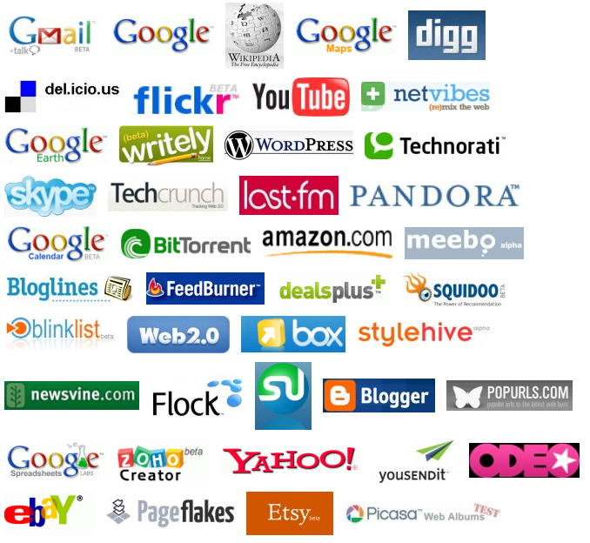

ICTs & Web 2.0 Tools
Source: http://web2list.com/logos/

Slide 3
Theoretical Background
Diffusion of Innovation (DoI) theory (Rogers, 1983):
Used to guide adoption of technologies by organizations and individuals
DoI has some limitations: dependent variable is % who actually adopt the innovation
People may inform others about new ICTs, not for the purpose of adoption
Adoption can also happened due to leaping resulting from informing one who inform others

Slide 4
Theoretical Background (Cont.)
Informing Science Framework – Cohen (1999)
Task-completion system
(task-client)
Delivery
System
Informing Environment

Slide 5

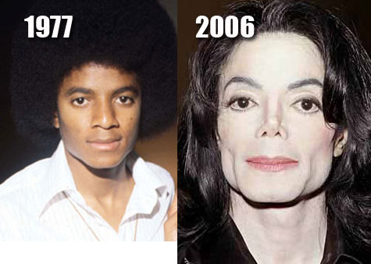
Example of Informing Framework
The client:
Facial reconstruction surgeon
The delivery system:
Electronic Medical Records
The informing environment:
Hospital and healthcare vendors
Sources: http://seattletimes.nwsource.com/ABPub/2008/12/11/2008496181.jpg
http://inyourface.ocregister.com/files/2009/06/michael-jackson-1977-2006-awfl-p-surg-dot-com.jpg

Slide 6
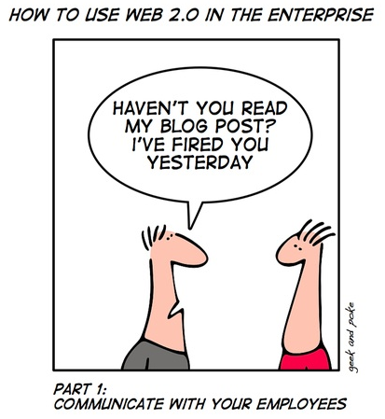
Web 2.0 Tools in the Enterprise?
Source: http://itmanagement.earthweb.com/article.php/3717971/Tech+Comics:+%22Getting+Fired,+Web+2.0+Style%22.htm

Slide 7
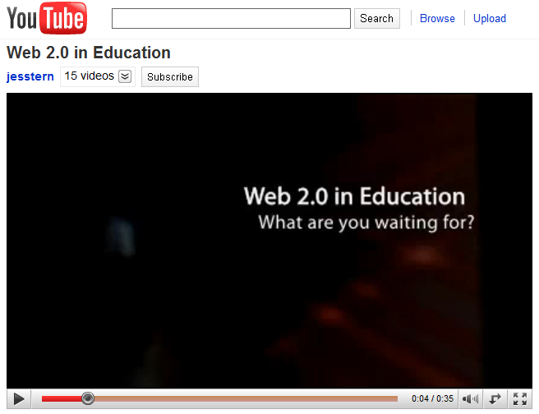
Web 2.0 in Education
http://www.youtube.com/watch?v=Kd-wwcLkmkw

Slide 8
The Research Questions (RQs)
RQ1: To what extent do individuals use various mature and emerging ICTs at their workplace?
RQ2: To what extent do individuals perceived the organizational relevance of mature and emerging ICTs that they currently use and/or have been exposed to outside their workplace?
RQ3: To what extent do individuals inform (talk & demonstrate) their co-workers and supervisors about mature and emerging ICTs that they have been exposed to outside their workplace?

Slide 9
The Six Mature and Emerging ICTs
E-mail
Social Networking Sites (SNS)
E-learning/e-training systems
Electronic Boards and Forums
Enterprise Resource Planning (SAP®)
Web 2.0 Presentation Tools (Animoto® & YouTube®)

Slide 10
Methodology and Sample
An introductory to MIS business course (exc MBA)
A general survey to ICTs in the context of value driven to businesses
Students engage in weekly activities using such mature and emerging ICTs
Two-phased methodology including quantitative and qualitative data collection
Assessing the extent of use, business relevance, and informing co-workers/supervisors (taking and/or demonstrating)

Slide 11

Initial Quantitative Results
80 responses
45 (56%) males and 35 (44%) females
Average age was 32 years
Majority, 56 (70%), where working full time
the rest were working PT (20 to 30 hrs weekly)
Company size:
    38 participants (or 48%) @ very large (>1000)
    16 participants (or 20%) @ large (100-1000)
    15 participants (or 18%) @ medium (25-99)
    11 participants (or 14%) @ small (<25)
Source: http://www.istockphoto.com/file_thumbview_approve/4332271/2/istockphoto_4332271-red-pencil-and-questionnaire.jpg

Slide 12
Initial Quantitative Results (Cont.)

Slide 13
Initial Quantitative Results (Cont.)

Slide 14

Initial Qualitative Results
42 individuals who participated in a follow-up questionnaire
Were asked to tell how they
informed their co-workers
and supervisors about the
ICTs discussed and
demonstrated in class
Source: http://smallbiztrends.com/wp-content/uploads/2010/01/question-things.jpg

Slide 15
Initial Qualitative Results (Cont.)
“I've suggested that we should use Facebook to promote our business to my supervisor”
“In reference to Web 2.0 tools, my workplace has blocked the use of social networking sites such as Facebook, Twitter, and YouTube”
“The reaction to the Animoto was excitement because most of my co-workers didn't know about it”

Slide 16
Initial Qualitative Results (Cont.)
“The most interesting technology discussed from the list was Wiki. No one at my work I spoke with had ever used one but seemed very interested in trying it”
“Since discussing and demonstrating Facebook and Twitter with colleagues, a few of them began social networking profiles to become familiar with the technologies”

Slide 17
Proposed Model of Informing Postures of Organizations vs. Personal ICTs

Slide 18
Taxonomy of Personal vs. Organizational ICTs Inform and Ownership

Slide 19
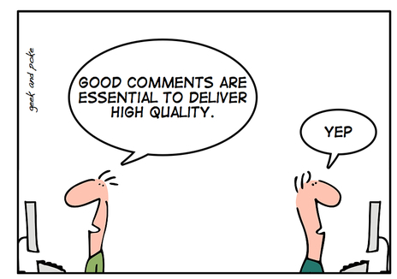
Thanks for attending !
Comments and feedback
please!

Slide 20
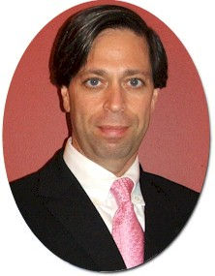
Contact Information - Yair
Yair Levy, Ph.D.
Associate Professor of Information Systems
Nova Southeastern University
Graduate School of Computer and Information Sciences
The DeSantis Building - Room 4058
3301 College Avenue
Fort Lauderdale, FL 33314
Tel.: 954-262-2006
Fax: 954-262-3915
E-mail: levyy@nova.edu
Site: http://scis.nova.edu/~levyy/

Slide 21
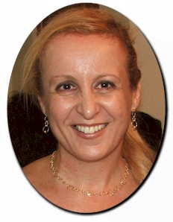
Contact Information - Michelle
Michelle M. Ramim, Ph.D.
Part-time Professor
Nova Southeastern University
Huizenga School of Business and Entrepreneurship
The DeSantis Building
3301 College Avenue
Ft. Lauderdale, FL 33314
E-mail: ramim@nova.edu
Site: http://www.nova.edu/~ramim/

