Slide 1
Life-Long Learning at the Technion: Students' Perceptions about Distance Education and their Learning Experiences
Rania Hussein-Farraj, Miri Barak and Yehudit J. Dori

Slide 2
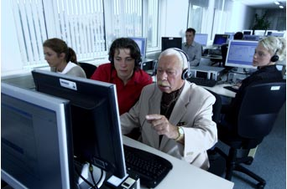
Introduction
Lifelong learning is the continuous pursuit
of knowledge and skills throughout an
individual's life for either personal or
professional reasons (Moore, 2007).
Advanced technologies can facilitate the delivery of learning materials anywhere and anytime (Allen & Seaman, 2010; Jones & O`shea, 2004).
The increasing demand for life-long learning via advanced technologies, resulted in the establishment of numerous online distance learning (DL) courses in higher education (Lee & Pituch, 2006).

Slide 3
Distance learning
Distance education enables professionals,
individually or through their employers, to adopt
life-long learning and continue specializing in
their workplaces at their own time and place (Moore, 2007).
DL can be conducted at the same time - synchronously, or at different times – asynchronously (Herring, 1996).
Although universities have expanded their use of DL and several studies suggest that DL can be as effective as on campus classroom models, few studies have focused on learner perceptions and learning experiences with online instruction, particularly in the transition to online learning from traditional approaches (Smart & Cappel, 2006).

Slide 4
Research goal
Our purpose was to examine the development of two distance learning courses and to characterize students' learning perceptions and experiences.

Slide 5
Research setting
The study was conducted in the framework of two courses:
Innovation Management – delivered as part of an MBA program at the Faculty of Industrial Engineering.
From Cell to Tissue – delivered as part of a Master in Engineering program at the Faculty of Biomedical Engineering.
The Moodle system (http://www.moodle.com), an open-source web application, was used as the learning management system for both groups.

Slide 6
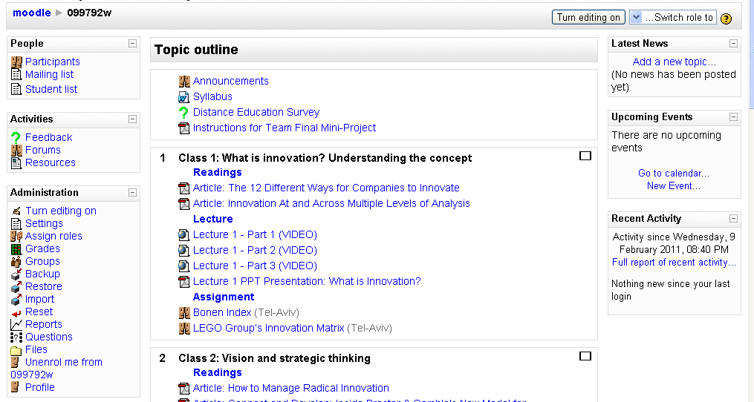
Learning environment

Slide 7
Learning environment

Slide 8
Research participants
Our study included (N=105) science and engineering students divided into two research groups:
On-campus students (N=70) who studied in lecture halls.
DL students (N=35) who studied online.
They were at the ages between 20-to-34 years old.
About 60% had an engineering background.
About 40% worked in industry and commercial companies.
About 40% studied to complete their MBA degree.
The distribution of gender was equal.

Slide 9
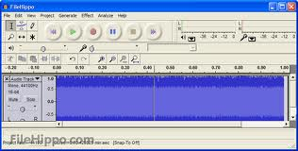
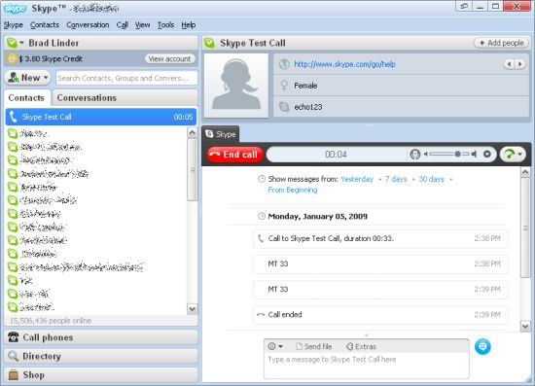
Research tools
Online questionnaire with open-ended questions.
Semi-structured interviews with DL students via
Skype, recorded by Audacity.

Slide 10
Research method
Content analysis was conducted by three educational research experts for establishing research trustworthiness via investigator triangulation (Denzin, 1978). The content analysis was conducted in four stages:
1. The students’ responses were collected.
2. Each response was divided into short sentences.
3. Each sentence was classified under a uniting theme.
4. Sentences under a similar theme were collected together, resulting in
the generation of categories.
The inter-raters consent was 100%.

Slide 11
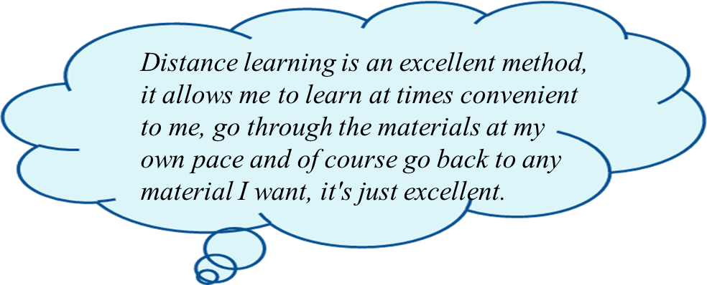
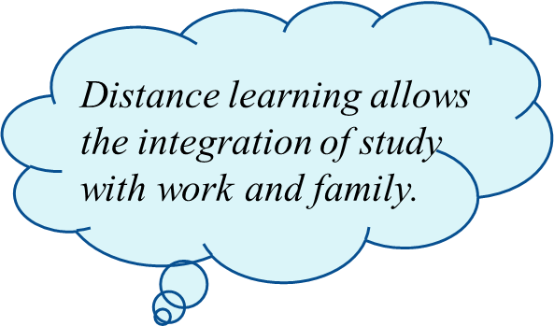
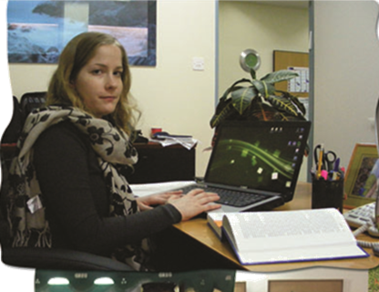
1. Findings: students’ positive perceptions about distance learning (70%)
Learning the
course from distance don`t compromises the quality of learning process but on the contrary, we can understand and implement what we learn

Slide 12
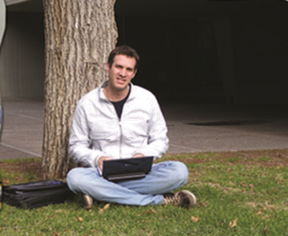
1. Findings: students’ negative perceptions about distance learning (30%)
DL does not provide a stable framework, I am afraid that I have no self-discipline .
DL lacks interaction with the lecturer. I can`t stop him in the middle and ask questions or participate in the discussion.
I think DL is not suitable for studying courses that need a lot of interaction.

Slide 13
2. Findings: Students’ learning experience
Content analysis of DL students’ answers indicated three categories and sub-categories relating to their learning experience.
The categories were based on Schraws’ Self-Regulation Theory (Schraw, 2012).
Metacognitive (Regulation of cognition)
Resource management
Cognitive learning strategies
Students’ learning experience

Slide 14
2. Findings: Students’ learning experience
Main category | Sub-category | Example
Cognitive learning strategies | Rehearsal | DL allows me to return to certain chapter and understand concepts better the second time.
 | Elaboration | DL provides required skills that can be employed in my workplace.
Metacognitive (Regulation of cognition) | Monitoring | In order to participate in DL course one needs very high self-discipline.
 | Planning | I want to learn from distance because that is the next trend and the future of learning methods. I want to practice and to know this system now.
 | Evaluation | Distance learning will be effective if there is a possibility for direct interactions with the lecturer and students.

Slide 15
2. Findings: Students’ learning experience
Example | Sub-category | Main category
DL has opened an opportunity to study on my own convenience, I can learn any time I wish. | Time | Resource management
I am interested in DL because of the convenience of learning from home in some of the courses. | Environment
DL provides opportunities to study with a large variety of well-known professors. | Information

Slide 16
2. Findings: Students’ learning experience
Students' learning experience
Cognitive learning strategies
Metacognitive (Regulation of cognition)
Resource management
Elaboration
Rehearsal
Monitoring
Planning
Evaluation
Time
Environment
Information

Slide 17
Conclusions
Most of the students (70%) indicated positive perceptions about DL.
They believe that DL should be conducted on their own time, pace, and place.
DL contributes to graduate students’ professional development in their workplace.
DL courses designers should take into consideration students’ regulation of cognition and their resource management.
To succeed in distance learning students need to self regulate their learning and to believe in their ability to monitor, plan, and manage their learning process.
Good and efficient communication between the students and the lecturer and between themselves, should be one of the major concerns in selecting DL technologies and designing DL courses.

Slide 18
Thanks
Rania Hussein-Farraj, Miri Barak and Yehudit J. Dori

