Slide 1
Procrastination in Online Exams: What Data Analytics Can Tell Us?
Yair Levy, Ph.D.
Graduate School of Computer and Information Sciences
Michelle M. Ramim, Ph.D.
Huizenga School of Business and Entrepreneurship

Slide 2
“Procrastination is the art of keeping up with yesterday.”
~Don Marquis 1878-1937 (journalist/author – NYC)

Slide 3
Introduction
Procrastination – Voluntary postponing an activity to the last possible minute (Gafni & Geri , 2010)
Ancient societies viewed procrastination in positive terms:
Avoid unnecessary work
Reduce impulsive behaviors
Information Systems (IS) produce huge data sets of all task logs
E-learning Systems produce massive data sets

Slide 4
What Can Be Learned From Data Sets?
Business Intelligence (BI) or Business Analytics (BA)
Data analytics is an emerging technique that dives into a data set without prior set of hypotheses
The data derive meaningful trends or intriguing findings that were not previously seen or empirically validated (Leventhal, 2010).
Data analytics enables quick decisions or help change policies due to trends observed

Slide 5
Data Analytics
Accumulation of raw data captured from various sources (i.e. discussion boards, emails, exam logs, chat logs in e-learning systems) can be used to identify fruitful patterns and relationships (Bose, 2009)
Exploratory visualization – uses exploratory data analytics by capturing relationships that are perhaps unknown or at least less formally formulated
Confirmatory visualization - theory-driven

Slide 6
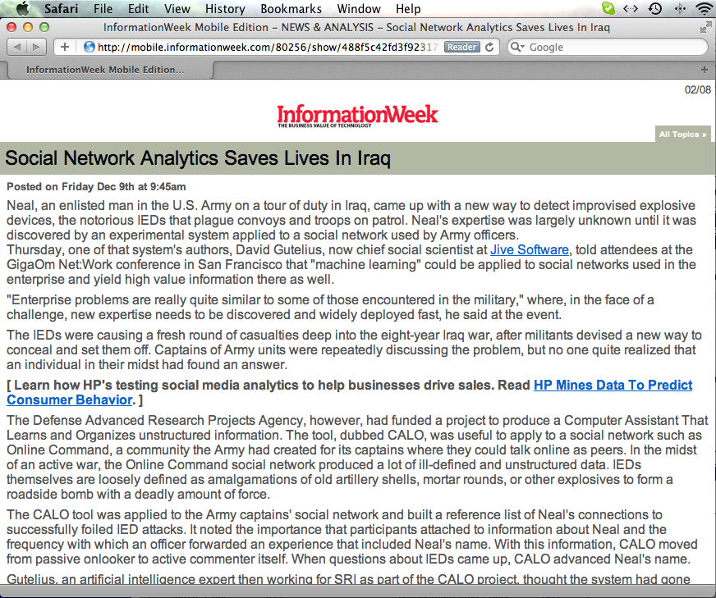
The Power of Data Analytics
Source: http://mobile.informationweek.com/80256/show/488f5c42fd3f92317e5ac29faeee033e/

Slide 7
Data Analytics vs. Statistical Analysis
Data Analytics
Utilizes data mining techniques
Identifies inexplicable or novel relationships/trends
Seeks to visualize the data to allow the observation of relationships/trends
Statistical Analysis
Utilizes statistical and/or mathematical techniques
Used based on theoretical foundation
Seeks to identify a significant level to address hypotheses or RQs

Slide 8
Research Goals
To uncover trends using data analytics about procrastination in online exams
To examine a data set related to procrastination in online exams for trends in terms of:
Task completion time
Task completion scores
Gender
Academic level
as time progress during the submission window
To understand how to improve online exams performance, time-learning strategies, and overall learning experience.

Slide 9
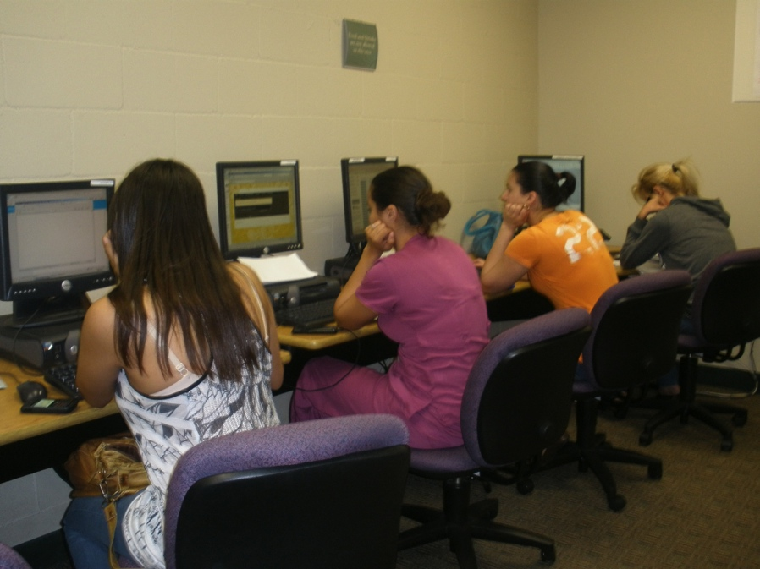
Methodology
The unit of analysis for this study is the task completed (i.e. an online exam)
A data set of 1,629 online exam records
Compiled from 10 courses distributed over five terms
~35 students/course
Six online exams/term

Slide 10
Data Extracted
Two main time related measures were extracted:
task completion window (Monday 12am to Sunday 12pm)
task completion time
Procrastination was measured based on the proximity to due time (in hr:min:sec)
The task completion time is the time that it took to complete the online exam (in min:sec)
Used SPSS 19, Excel 2011, and Google Visualization (Motion Chart Gadget: http://code.google.com/apis/chart/ interactive/docs/gallery/motionchart.html)

Slide 11
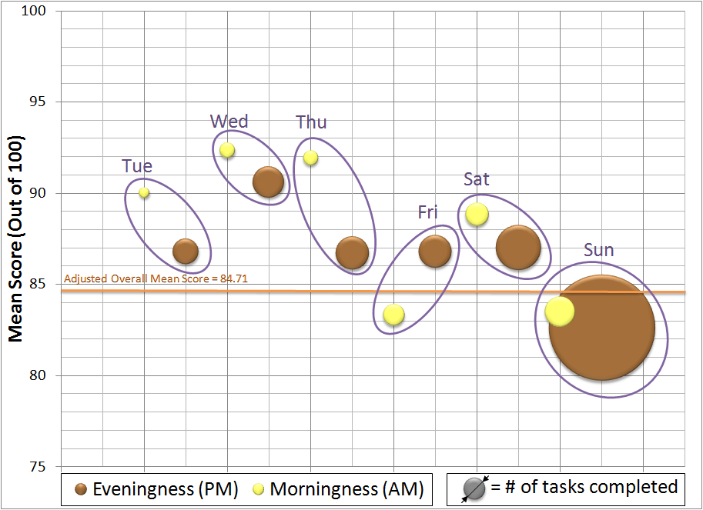
Procrastination (Day) based on Morningness-Eveningness

Slide 12
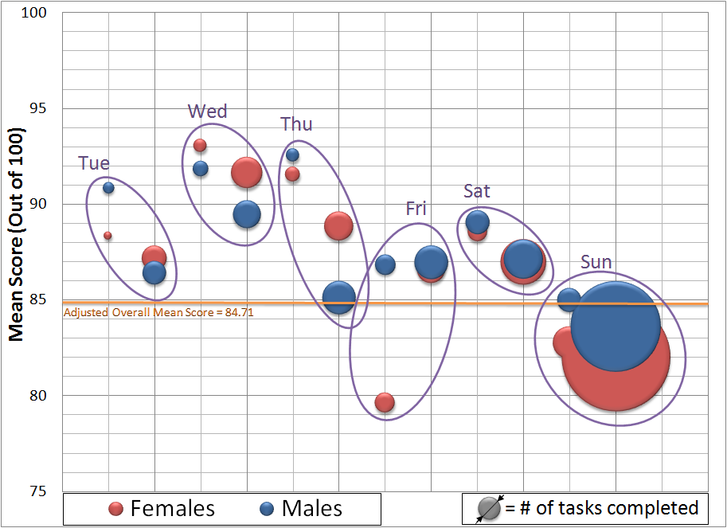
Procrastination (Day) based on Morningness-Eveningness and Gender

Slide 13
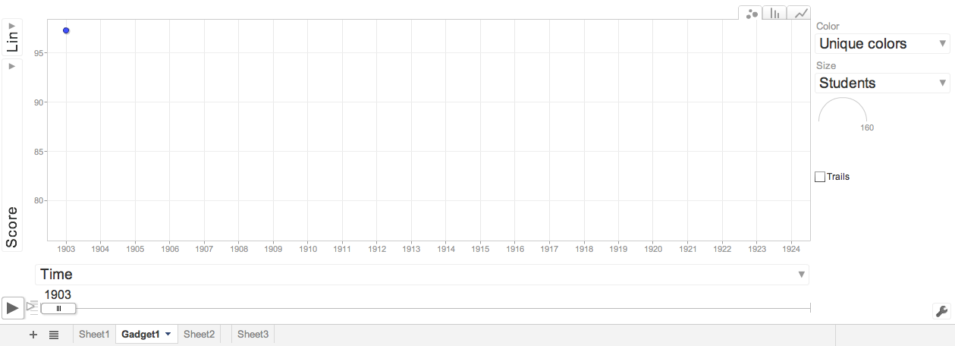
Data Visualization with Google Motion Chart – Sunday (n=955)

Slide 14
Data Visualization with Google Motion Chart – Sunday (n=955)
http://www.youtube.com/watch?v=Bt4rHaOteoo&context=C3e76fabADOEgsToPDskLwDu1YsJZADHxbMC97mc0j

Slide 15
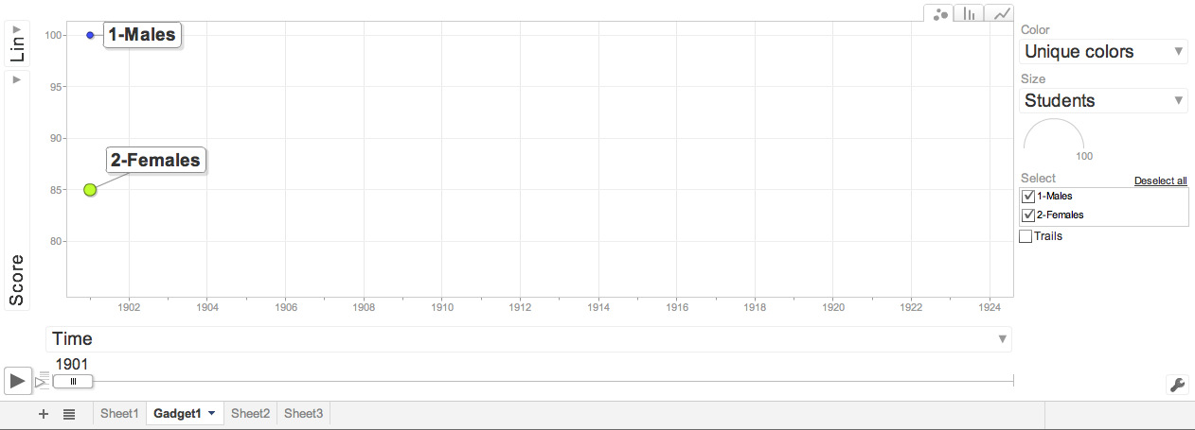
Data Visualization with (Gender) Google Motion Chart – Sunday (n=955)

Slide 16
Data Visualization with (Gender) Google Motion Chart – Sunday (n=955)
http://www.youtube.com/watch?v=imMeqm1K4nA&context=C379f25aADOEgsToPDskL7vxQ52aKGXCkKsCcyGfSQ

Slide 17
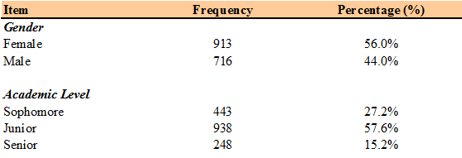
Descriptive Statistics and Demographics
(N=1,629)

Slide 18
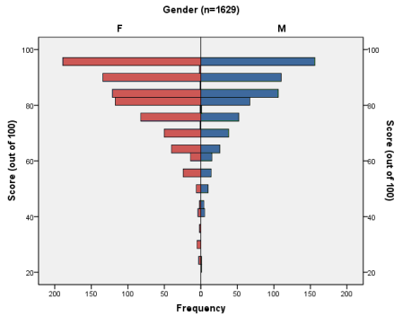
Scores per Gender

Slide 19
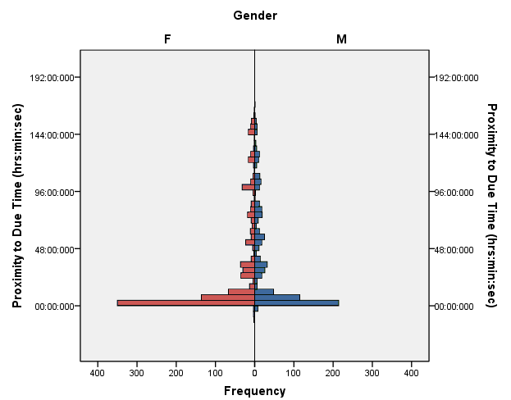
Procrastination per Gender

Slide 20
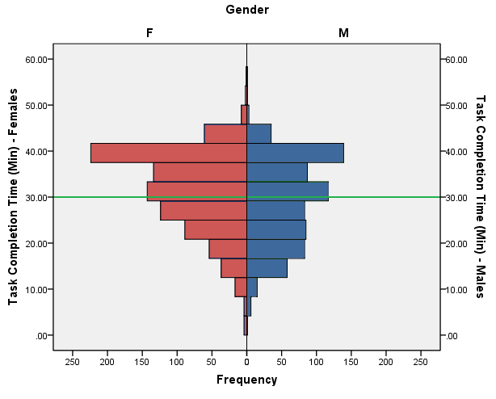
Task Completion Time per Gender

Slide 21
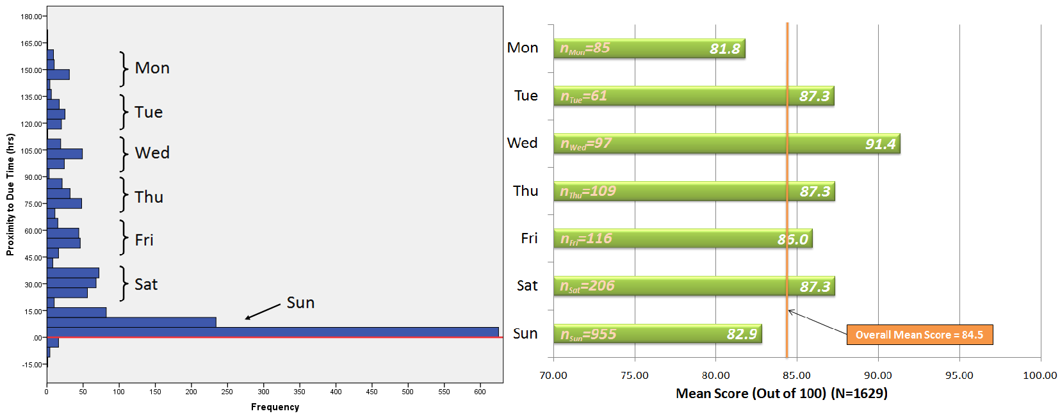
Procrastination (hrs) and Scores

Slide 22
Procrastination (hrs) and Scores

Slide 23
Procrastination (hrs) and Scores

Slide 24
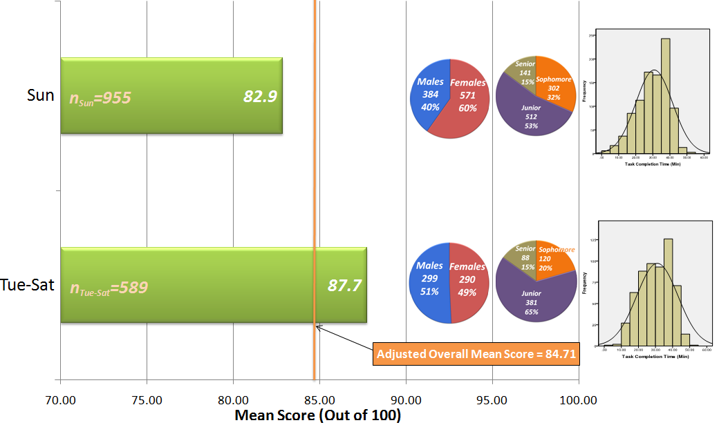
Data Analytics

Slide 25
Summary of Findings
Our data analytics showed that:
Over 58% procrastinated to the last day
About 40% procrastinated to the last 12 hours
Significantly* more younger students procrastinate
Percentage-wise, more females procrastinated
Enormous demand is placed on females (i.e. working mothers, balance work during the weekdays and family obligations during the weekends)
* p<0.001

Slide 26
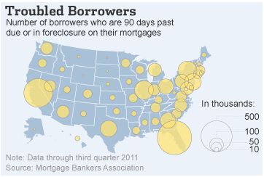
Data Analytics is Here to Stay!
Source: The Wall Street Journal

Slide 27
Data Analytics is Here to Stay!
Source: GapMinder.org

Slide 28
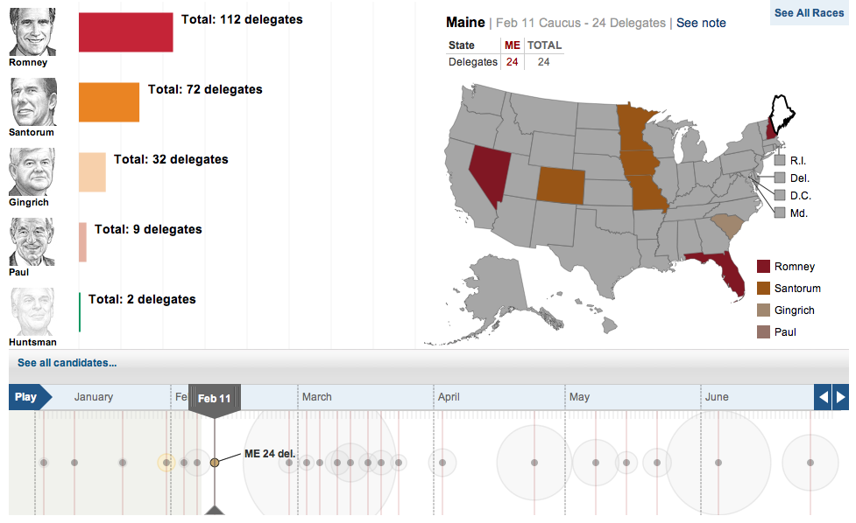
Source: The Wall Street Journal

Slide 29
Bottom Line!
Procrastination during the week doesn’t pay off!

Slide 30
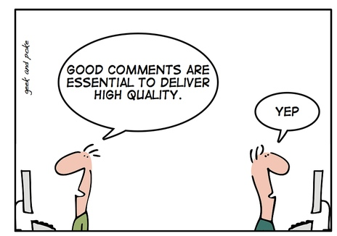
Thank you!
Comments and feedback are welcome!

Slide 31
Contact Information - Yair
Yair Levy, Ph.D. Associate Professor of Information Systems Nova Southeastern University Graduate School of Computer and Information Sciences The DeSantis Building - Room 4058 3301 College Avenue Fort Lauderdale, FL 33314 Tel.: 954-262-2006 Fax: 954-262-3915
E-mail: levyy@nova.edu
Site: http://scis.nova.edu/~levyy/

Slide 32
Contact Information - Michelle
Michelle M. Ramim, Ph.D. Part-time Professor Nova Southeastern University Huizenga School of Business and Entrepreneurship The DeSantis Building 3301 College Avenue Ft. Lauderdale, FL 33314
E-mail: ramim@nova.edu
Site: http://www.nova.edu/~ramim/

