Slide 1
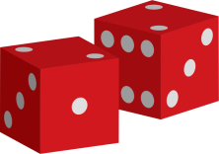
First sample, then be greedy: an improved way to use the greedy algorithm
Moran Feldman
The Open University of Israel
Based on the paper: “Greed Is Good: Near-Optimal Submodular Maximization via Greedy Optimization”.
To appear in COLT 2017.
Joint work with Christopher Harshaw and Amin Karbasi.

Slide 2

Problems of Interest
max f(S)
s.t. S ⊆ N
S obeys a constraint C
Given a ground set N.
The greedy algorithm is often used for such problems in practice.
The size of S must be at most k.
S must be a legal matching.
The Greedy Algorithm
While there are more elements that can be added to the solution, pick the element among them whose addition to the solution increases the value by the most, and add it.

Slide 3

Why does it Work?
Intuitively, means that given an element e and a feasible set S, to make S + e feasible we need to remove up to k elements of S.
Examples:
  Matroid constraint
  Matching constraint
  Any intersection of such constraints
Theoretical results show that the greedy algorithm guarantees a good approximation ratio when:
The objective function is submodular.
The constraint belongs to one of a few general families of constraints.
A general family of functions generalizing linear functions. Will be discussed more in a minute…
Here we consider a family named: “k-extendible systems”.

Slide 4
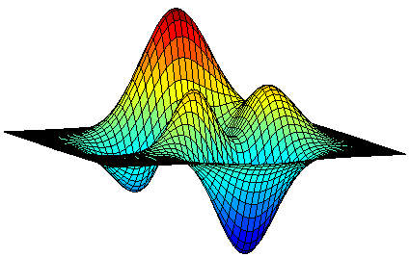
Submodular Functions
Intuition
A function is submodular if it captures the concept of diminishing returns:
Adding an element to a small set increase the objective by more compared to adding this element to a large set.
Definition
A set function f: 2^{N} → ℝ is submodular if:
f(A + u) – f(A) ≥ f(B + u) – f(B) ∀ A ⊆ B ⊆ N, u ∉ B or
f(A) + f(B) ≥ f(A ∪ B) + f(A ∩ B) ∀ A, B ⊆ N .
Submodular functions can be found in:
Combinatorics (2 examples soon)
Algorithmic Game Theory
Image Processing
Machine Learning

Slide 5

Example 1: Cut Function
A directed graph G = (V, E) with capacities c_{e} ≥ 0 on the arcs.
For every S ⊆ V:
Observation: f(S) is a non-negative submodular function.
f(S) = 3

Slide 6

Example 2: Coverage Function
Elements E = {e₁, e₂, …, e_{n}} and sets s₁, s₂, …, s_{m} ⊆ E.
For every S = {s_{i1}, s_{i2}, …, s_{ik}}:
Observation: f(S) is a non-negative monotone submodular function.
S₂
Adding elements can only increase the values of sets.
For sets A ⊆ B ⊆ N, f(A) ≤ f(B).
S₃
S₁
S₄
S₅

Slide 7

Known Results
[Fisher et al. (1978), Jenkyns (1976)]
If
f is a non-negative monotone submodular function.
C is a k-extendible system
Then
Then, the greedy algorithm is a (k + 1)-approximation algorithm for the problem
max f(S)
s.t. S ⊆ N
S obeys a constraint C
Remark
If f is linear, the approximation ratio improves to k.

Slide 8

Our Contribution
Our algorithm
Create a sample set S containing every element of N with probability p, independently.
Run the greedy algorithm on S (instead of on N).
If p = 1/k or p = 1/(k + 1), there is no loss in the approximation ratio, just a speed up.
What do we get?
Runs faster than the greedy algorithm.
Approximation ratio:
Another advantage will be described later…
For linear functions:
max{k, 1/p}
For non-negative montone submodular functions:
max{k + 1, 1/p}

Slide 9

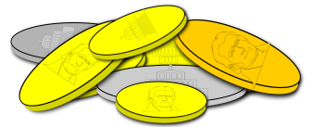

Greedy Analysis Idea
The presentation of the analysis assumes a linear function.
For every iteration of the greedy algorithm, we are interested in two entities:
The gain of the iteration is the increase in the value of the solution during that iteration.
The damage of the iteration is the decrease, during the iteration, in the difference between:
The value of the solution.
The maximum value of a feasible set containing the solution.
What we can potentially get.
If c ∙ Gain ≥ Damage, then the approximation ratio is at most c.

Slide 10
Greedy Analysis Idea (cont.)
Greedy picks correctly
It picks an element from the (current) optimal solution.
No change in the value of the optimal solution.
Greedy picks incorrectly
It picks an element outside of the (current) optimal solution.
At most k other elements have to be removed from the optimal solution.
The removed elements are less valuable than the added one.
Not balanced!
Both are equal to the change in the value of the solution.
Change in OPT
≥
≤
k ∙
k ∙

Slide 11
How does the Sampling Comes in?
An alternative view on our algorithm
Run greedy.
When greedy tries to select an element:
  With probability p, select it.
  Otherwise, remove it from the instance.
Observation
Iterations in which the element is added behave like in standard greedy.
Big question: what happens in iterations in which the element is removed?

Slide 12
Analyzing Non-selecting Iterations
The solution does not change:
0
Greedy picks correctly
The dismissal removes an element from the current optimal solution.
Let e denote the element greedy tries to select.
Greedy picks incorrectly
The dismissal does not change the current optimal solution.
0
≤
f(e)

Slide 13
Summing It All Up
Greedy picks correctly
Greedy picks incorrectly
Selecting iteration (probability p)
≤
k ∙
In both cases
f(e)
≤
max{k, 1/p} ∙
0
Non-selecting iteration (probability 1 – p)
≤
f(e)
0
p∙ f(e)
Expectation
≤
k ∙
≤
f(e)

Slide 14
Result for Non-monotone Functions
For non-negative (non-monotone) submodular functions:
The greedy algorithm has no theoretical guarantee,
even in the absence of a constraint.
Intuitively, the algorithm works because no single “bad” element can be selected with high probability.
Our algorithm (sampling + greedy) works for this case as well.
For an appropriate choice of the parameter p, it achieves an approximation ratio of k + 2 + 1/k.

Slide 15
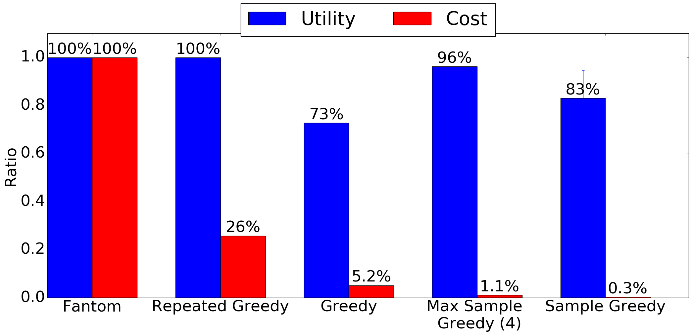
Experiment

Slide 16
Questions
?

