Slide 1
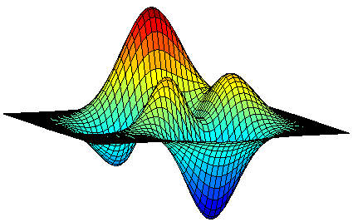
Submodular Maximization Through the Lens of the Multilinear Relaxation
Moran Feldman
The Open University of Israel

Slide 2


Submodular Functions
5
Formal Definition
Given a ground set N, a set function f : 2^{N} → R assigns a number to every subset of the ground set.
A set function is submodular if:
  f(A + u) – f(A) ≥ f(B + u) – f(B) ∀ A ⊆ B ⊆ N, u ∉ B.
4
3
7
11
  Equivalently,
  f(A) + f(B) ≥ f(A ∪ B) + f(A ∩ B) ∀A, B ⊆ N.
0
N
6
8
11
5
10
2

Slide 3
Submodular Maximization Problems
Submodular functions can be found in:
Combinatorics
Machine Learning
Image Processing
Algorithmic Game Theory
Motivated the study of maximization problems with a submodular objective function.
One of the first example studied:
  Maximizing a non-negative monotone submodular function subject to a cardinality constraint.

Slide 4
Maximization with a Cardinality Constraint
1
2
3
Maximizing a non-negative monotone submodular function subject to a cardinality constraint.
The Greedy Algorithm
Start with the empty solution.
Do k times:
Add to the solution the element contributing the most.
Objective
A non-negative monotone submodular function.
Constraint
A set of size at most k (k is a parameter).
Polynomial in n = |N|.
  f(A) ≤ f(B) ∀ A ⊆ B ⊆ N.
Approximation ratio:
1 – 1/e ≈ 0.632
[Nemhauser et al. 1978]
A polynomial time algorithm cannot achieve a better approximation ratio.
[Nemhauser and Wolsey 1978]

Slide 5
More General Problems
Unfortunately, the greedy algorithms is not optimal for even slightly more general problems.
A breakthrough was finally achieved only when relaxation based techniques entered the picture.
For non-monotone functions: a non-constant approximation ratio.
For partition matroid constraints: ½-approximation. [Fisher et al. 1978]
Both can be improved
Submodular maximization research in the 20th century used combinatorial methods (greedy rules and local search).
Unfortunately, it failed to improve over the standard greedy algorithm even for the above simple extensions.

Slide 6
The Multilinear Relaxation
In the Linear World
Solve a linear program relaxation.
Round the solution.
In the Submodular World
Solve a relaxation.
Round the solution.
Solve a multilinear relaxation.
max w ∙ x
s.t. x ∈ P
max
s.t. x ∈ P
max F(x)
s.t. x ∈ P
It is a multilinear function…
The multilinear extension
Linear extension of the objective:
Agrees with the objective on integral vectors.
The Multilinear Extension
Given a vector x ∈ [0, 1]^{N},
F(x) is the expected value of f
on a random set R(x) containing each element e ∈ N with probability x_{e}, independently.

Slide 7
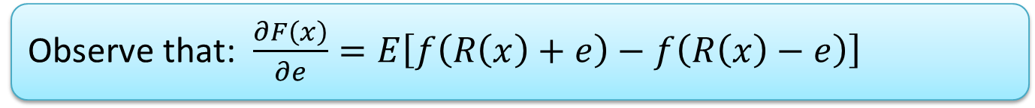
Optimizing the Multilinear Relaxation
Lemma
The multilinear relaxation is concave along positive directions.
Use
Regardless of our current location, there is a good direction:
If y is the current solution,
then moving a δ fraction of the distance towards y ∨ OPT,
gives us a value of at least
δ ∙[F(y ∨ OPT) – F(y)].
Fact
For small δ, the function is locally almost linear.
Finding the best direction (in some set) reduces to LP solving.
For monotone functions, ≥ f(OPT).
Observe that: $\frac{∂F\left(x\right)}{∂e}=E\left[f\left(R\left(x\right)+e\right)−f\left(R\left(x\right)−e\right)\right]$

Slide 8

Continuous Greedy [Calinescu et al. 2011]
Definition
The set of possible directions are the points of the polytope.
Feasibility: after 1/δ we end up with a convex combination of points in the polytope.
The direction towards F(y ∨ OPT) is OPT ∧ (1 – y).
Approximation Ratio
We make 1/δ steps.
In each step, we gain (roughly) δ ∙[F(y ∨ OPT) – F(y)].
Differential equation:
$\frac{dF(y)}{dt}=F\left(y \text{∨} OPT\right) −F\left(y\right)$.
In the polytope when it is down-closed.

Slide 9
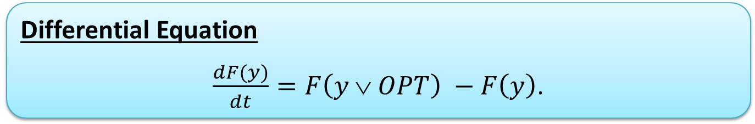
Result for Monotone Functions
Differential Equation
$\frac{dF(y)}{dt}=F\left(y \text{∨} OPT\right) −F\left(y\right)$.
For Monotone Functions
F(y ∨ OPT) ≥ f(OPT).
Solution: F(y) ≥ (1 - e^{-t}) ∙ f(OPT).
For t = 1, the approximation ratio is 1 – 1/e ≈ 0.632.
Tight since one can round with no loss for cardinality constraints.
Tight since one can round with no loss for cardinality constraints.
Theorem
When P is down-closed and f is a non-negative monotone submodular function, the multilinear relaxation can be optimized up to a factor of 1 – 1/e.

Slide 10
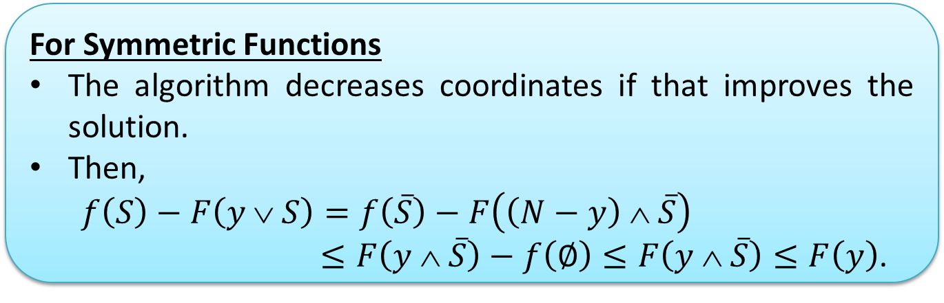
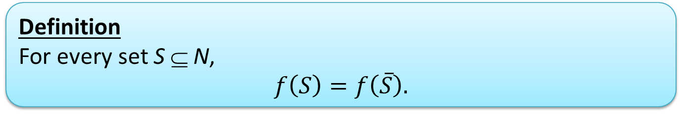
Symmetric Functions [Feldman 2017]
Definition
For every set S ⊆ N,
$$f\left(S\right)=f\left(\overline{S}\right).$$
Open Problem
Can that factor be improved?
An impossibility of 0.5 + ε follows from [Feige et al. 2011].
For Symmetric Functions
The algorithm decreases coordinates if that improves the solution.
Then,
$$f\left(S\right)−F\left(y \text{∨} S\right)=f\left(\overline{S}\right)−F\left(\left(N−y\right) ∧ \overline{S}\right)$$
$≤F\left(y ∧ \overline{S}\right)−f\left(∅\right)≤F\left(y ∧ \overline{S}\right)≤F\left(y\right)$.
F(y ∨ OPT) ≥ f(OPT) – F(y).
Theorem
When P is down-closed and f is a non-negative symmetric submodular function, the multilinear relaxation can be optimized up to a factor of (1 – e⁻²)/2.
Plugging into the Differential Equation
Solution: F(y) ≥ 0.5 ∙ (1 - e^{-2t}) ∙ f(OPT).
For t = 1, the approximation ratio is (1 – e⁻²)/2 ≈ 0.432.

Slide 11
General Sub. Functions [Feldman et al. 2011]
F(y ∨ OPT)
OPT
Random bits realization
Elements
Plugging into the Differential Equation
F(y ∨ OPT) ≥ (1 – t) ∙ f(OPT).
Solution: F(y) ≥ (2 - t - 2e^{-t}) ∙ f(OPT).
For t = ln 2, the approximation ratio is 1 – ln 2 ≈ 0.307.

Slide 12
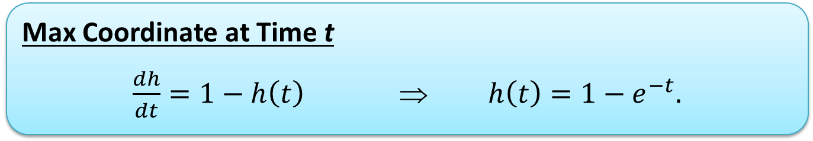
General Sub. Functions (cont.)
Recall
Our analysis needs the direction towards F(y ∨ OPT), which is OPT ∧ (1 – y), to be among the directions considered.
Recall
Our analysis needs the direction towards F(y ∨ OPT), which is OPT ∧ (1 – y), to be among the directions considered.
Mesured Continuous Greedy
Observation
This direction increases a coordinate e by at most δ(1 – y_{e}).
We can limit ourselves to directions having this property.
Observation
This direction increases a coordinate e by at most δ(1 – y_{e}).
We can limit ourselves to directions having this property.
Max Coordinate at Time t
$\frac{dh}{dt}=1−h\left(t\right)$ ⇒ $h\left(t\right)=1−e^{−t}.$
Plugging into the Differential Equation
F(y ∨ OPT) ≥ (1 – t) ∙ f(OPT).
Solution: F(y) ≥ (2 - t - 2e^{-t}) ∙ f(OPT).
For t = ln 2, the approximation ratio is 1 – ln 2 ≈ 0.307.
Plugging into the Differential Equation
F(y ∨ OPT) ≥ e^{-t} ∙ f(OPT).
Solution: F(y) ≥ t ∙ e^{-t} ∙ f(OPT).
For t = 1, the approximation ratio is e⁻¹ ≈ 0.367.

Slide 13

Further Improvements for General Functions
Open Problem
Can that factor be improved?
An impossibility of 0.478 follows from [Oveis Gharan and Vondrák 2011].
Objective
Further improving the bound on F(y ∨ OPT).
Approximation ratio of 0.385.
Approximation ratio of 0.372.
Approach [Buchbinder et al. 2014, Ene and Nguyen 2016]
Further reduce the speed in which the direction increases coordinates.
Analysis
If results in a poor direction, the original direction had a large overlap with OPT.
Use an unconstrained maximization algorithm inside the original direction.
Approach [Buchbinder and Feldman 2016]
Try to optimize the multilinear relaxation using a continuous local search (gradient accent) algorithm.
If the local search algorithm produces a poor solution z, run measured continuous greedy, but make it avoid z at the beginning.
Analysis Idea
See the next slide.
Theorem
When P is down-closed and f is a non-negative submodular function, the multilinear relaxation can be optimized up to a factor of 0.385.

Slide 14

Analysis Idea
Continuous local search outputs a poor vector z
Due to submodularity, all the elements together are responsible for at most f(OPT) damange.
F(z ∧ OPT) is small
F(z ∨ OPT) is small
More accurately, the average of F(z ∨ OPT) and F(z ∧ OPT) is small.
-z ∧ (N \ OPT) is a negative direction.
Avoiding z is not much loss.
z is responsible for a lot of damage to OPT.
Avoiding z at the beginning makes sense.

Slide 15

Shortcomings of the Above Algorithms
Randomization
The above algorithms appear to be deterministic.
However, they are randomized because evaluating the multilinear extension F (usually) requires sampling.
We will see that these can be fixed in some cases.
However, finding general solutions is open.
Efficiency
The algorithms require a lot of function evaluations because:
They have to make small steps to simulate continuity.
Approximating the multilinear extension requires many samples.

Slide 16
Rounding
Techniques for Specific Constraint Types
Pipage rounding [Calinescu et al. 2011]
Swap rounding [Chekuri et al. 2010]
Constant number of knapsack constraints [Kulik et al. 2013]
….
= 1
Creates only anti-correlations!
(Simple) Partition Matroid Constraint
≤ 1
≤ 1
≤ 1
≤ 1

Slide 17
Rounding (cont.)
Techniques for Wide Range of Constraint Types
Contention Resolution Schemes [Chekuri et al. 2014]
Online Contention Resolution Schemes [Feldman et al. 2016]
c
R(x)
R(x)
c₁
c₂
c₃
M
Matching
Constraint
Matching
Constraint
Knapsack
Constraint
Matroid
Constraint

Slide 18
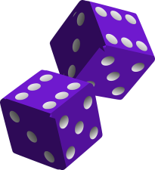
Derandomization
Old Result
Maximizing a monotone submodular function subject to a cardinality constraint (the greedy algorithm).
[Nemhauser et al. 1978]
New Results [Buchbinder and Feldman 2016]
Maximizing a submodular function subject to a cardinality constraint.
Unconstrained submodular maximization.
?
Open Problem
Dealing with a more involved constraint.
Even a partition matroid constraint with a monotone submodular objective function.

Slide 19
Random Greedy
The Algorithm
Start with the empty solution.
Do k times:
Let M be the set of the k items with the largest marginal contributions.
Add to the solution a random element from M.
Analogous to the earlier observation that,
for a vector x in which no coordinate is larger than t,
F(x ∨ OPT) ≥ (1 – t) ∙ f(OPT).
Analysis Summary
Achieves an approximation ratio of 1/e.
Main new idea:
  After i iterations, the solution S contains no element with probability larger 1 – (1 – 1/k)^{i}.
  This implies E[f(S ∪ OPT)] ≥ (1 – 1/k)^{i} ∙ f(OPT).

Slide 20
Derandomization – Naïve Attempt
Idea
Explicitly store the distribution over the current state of the algorithm.
(S₀, 1)
The number of states can increase exponentially with the iterations.
The initial state
(S₁, p)
(S₂, 1 - p)
(S₃, q₁)
(S₆, q₄)
(S₄, q₂)
(S₅, q₃)

Slide 21

Strategy
S
Can be done by finding a basic feasible solution of an LP.
p(S, S₁)
p(S, S₂)
p(S, S₃)
S₁
S₂
S₃
The state S_{i} appears in the distribution of the next iteration only if p(S, S_{i}) > 0.
We want moving probabilities that:
  are mostly zero.
  globally, keeps the probability of every element to belong to the solution low.

Slide 22
Faster Algorithms
Greedy
Works for many constraints. [Fisher et al. 1978]
Can be accelerated using sampling. [Feldman et al. 2017].
Out Intention
Algorithms that roughly match the approximation ratio of (measured) continuous greedy.
Results
Cardinality constraint
  Monotone: O(n log ε⁻¹) [Mirzasoleiman et al. 2015]
  Non-monotone: min{Õ(nε⁻²), Õ(n/ε + k(n/ε)^{0.5})} [Buchbinder et al. 2015]
Matroid constraint, monotone: O_{ε}(k² + nk^{0.5}) [Badanidiyuru and Vondrák 2014, Buchbinder et al. 2015]
For monotone functions: 1 – 1 / e – ε
For non-monotone functions: 1 / e – ε

Slide 23

Insight 1 – Step Size
Objective
Make less steps / increase the step size.
Difficulty
The value of a direction is no longer approximately linear.
Seems to be as hard as the original problem: increasing one coordinate decreases the contribution from others.
Solution
After the step, moving towards OPT still has a good value.
Compared to that, we can do good by selecting the direction greedily.

Slide 24
Insight 2 - Sampling
Standard Sampling
Continuous greedy uses sampling to estimate the marginal contributions of elements.
Done by estimating every marginal up to an additive error of ε ⋅ f(OPT) / k.
  Guarantees that the total marginal of an independent set is at most ε ⋅ f(OPT).
If no independent set has a large total singleton value, we are done.
We will see an algorithm reducing to this case.
No singleton is larger than f(OPT).
Requires many samples because individual samples can belong to all the range [0, f(OPT)].
However, this can only happen when the total singleton value of an independent set is large compared to f(OPT).

Slide 25

Residual Random Greedy
The Algorithm
Start with the empty solution S.
Do k times:
Let M a set such that S ∪ M is independent maximizing the total marginal contributions.
Add to S a random element from M.
Iteration Damage
The expected decrease in the value of the optimal solution.
Upper bounded by f(OPT)/k since every element of OPT has a 1/k chance to be lost.

Slide 26

Residual Random Greedy (cont.)
Iteration Gain
The expected increase in the value of the solution.
If large compared to the damage, then we are in a good shape.
iterations

Slide 27
Small Gain
The gain is small (compared to the damage)
No set complementing the current solution has a large total marginal compared to f(OPT).
Consider the residual problem:
In this problem the elements of the current solution are implicitly selected.
No set has a large total singleton value compared to f(OPT).

Slide 28
Questions
?

